Slide 1
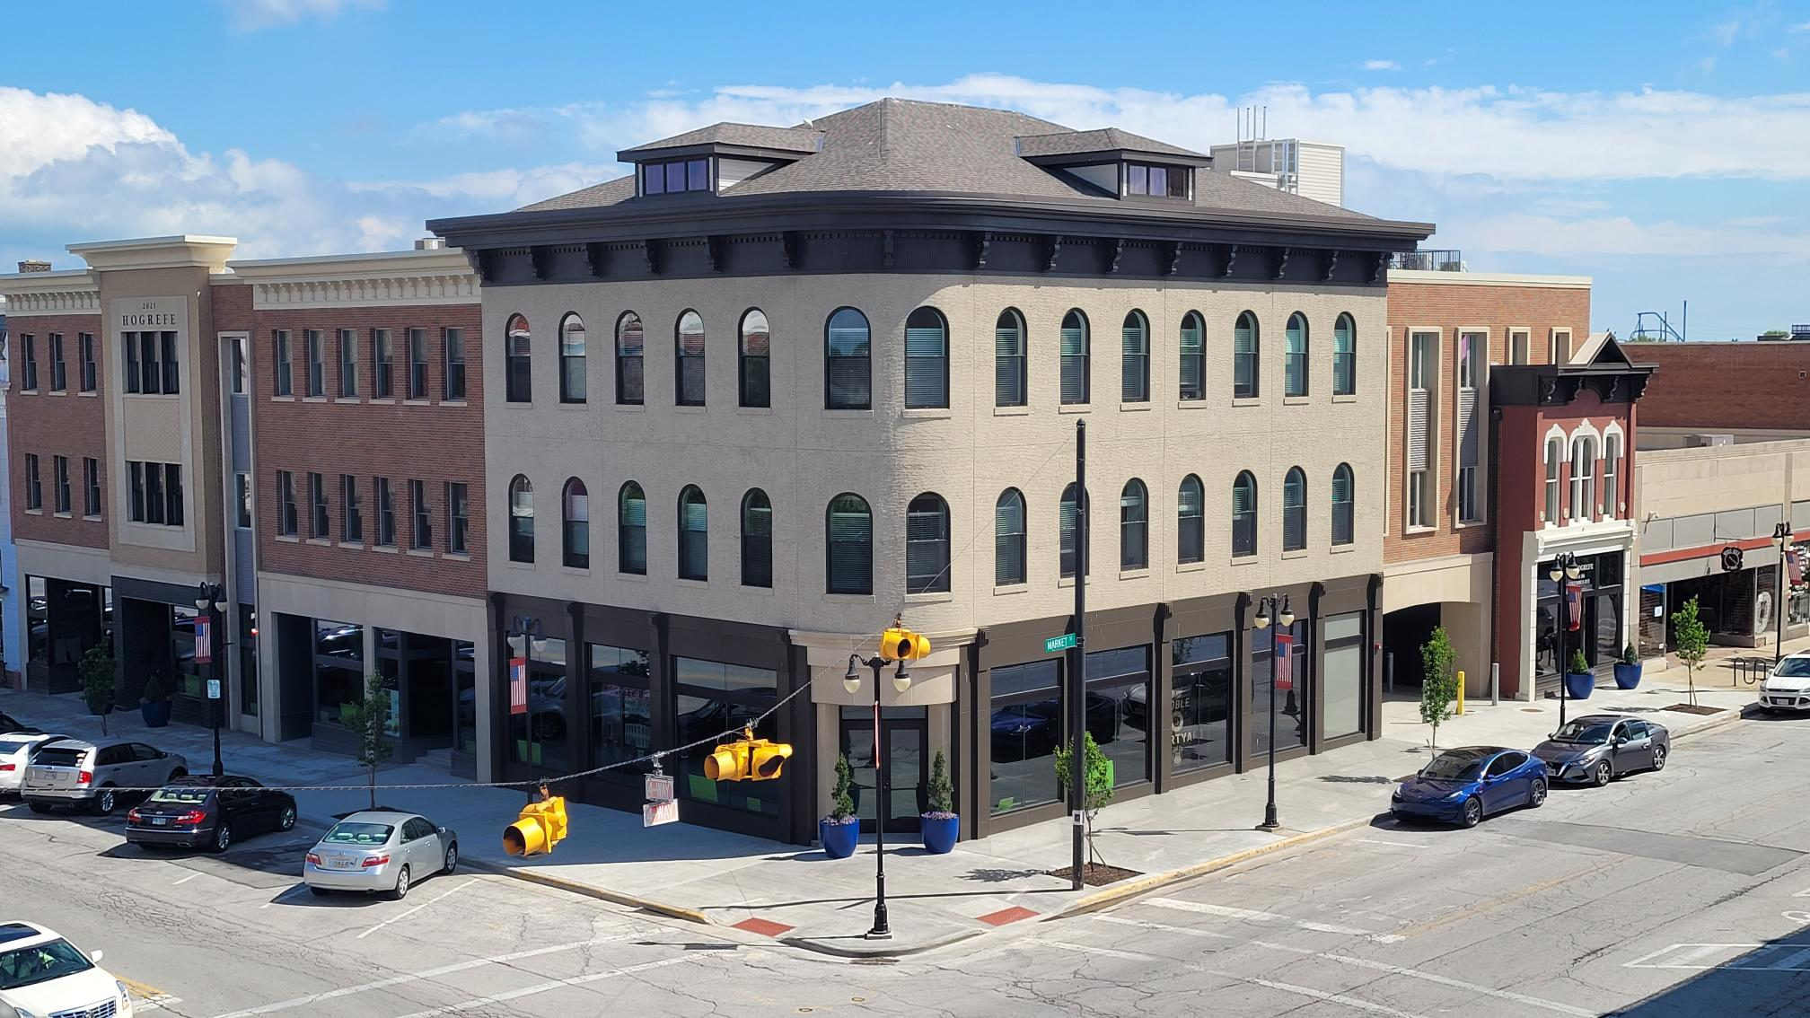
Building for the Future of downtown Sandusky
A Prospectus for Potential Commercial Tenants
6/25/2023 version

Slide 2
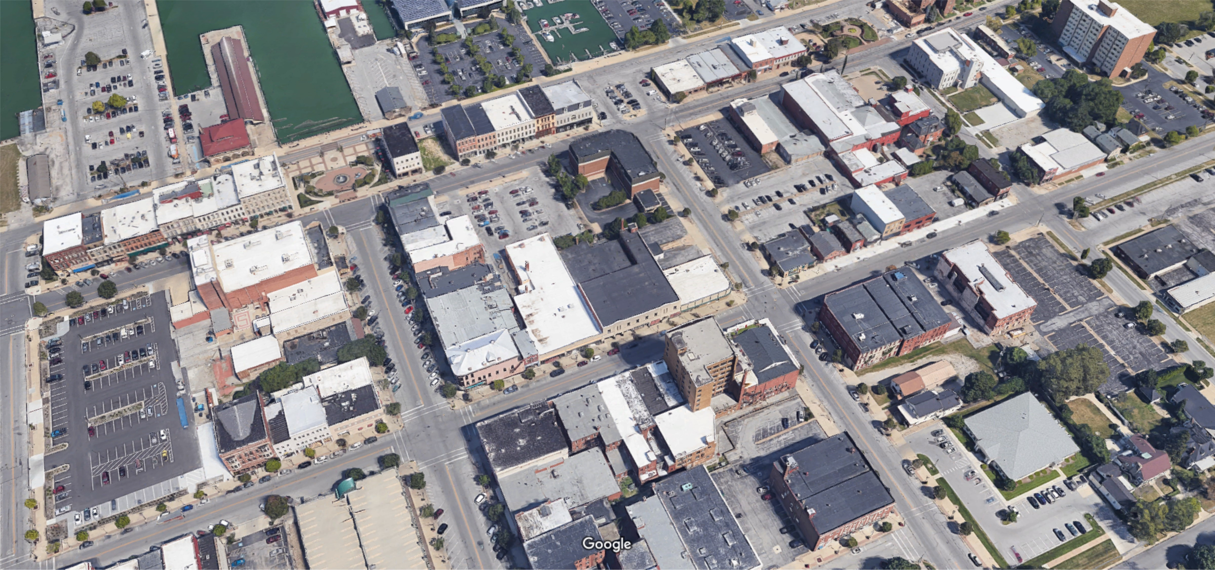
exclusive locations in the Heart of Downtown Sandusky
H2 PROPERTIES downtown give you built - in foot traffic for business
Primary Location for all business types
RESTAURANT/OFFICE/RETAIL

Slide 3
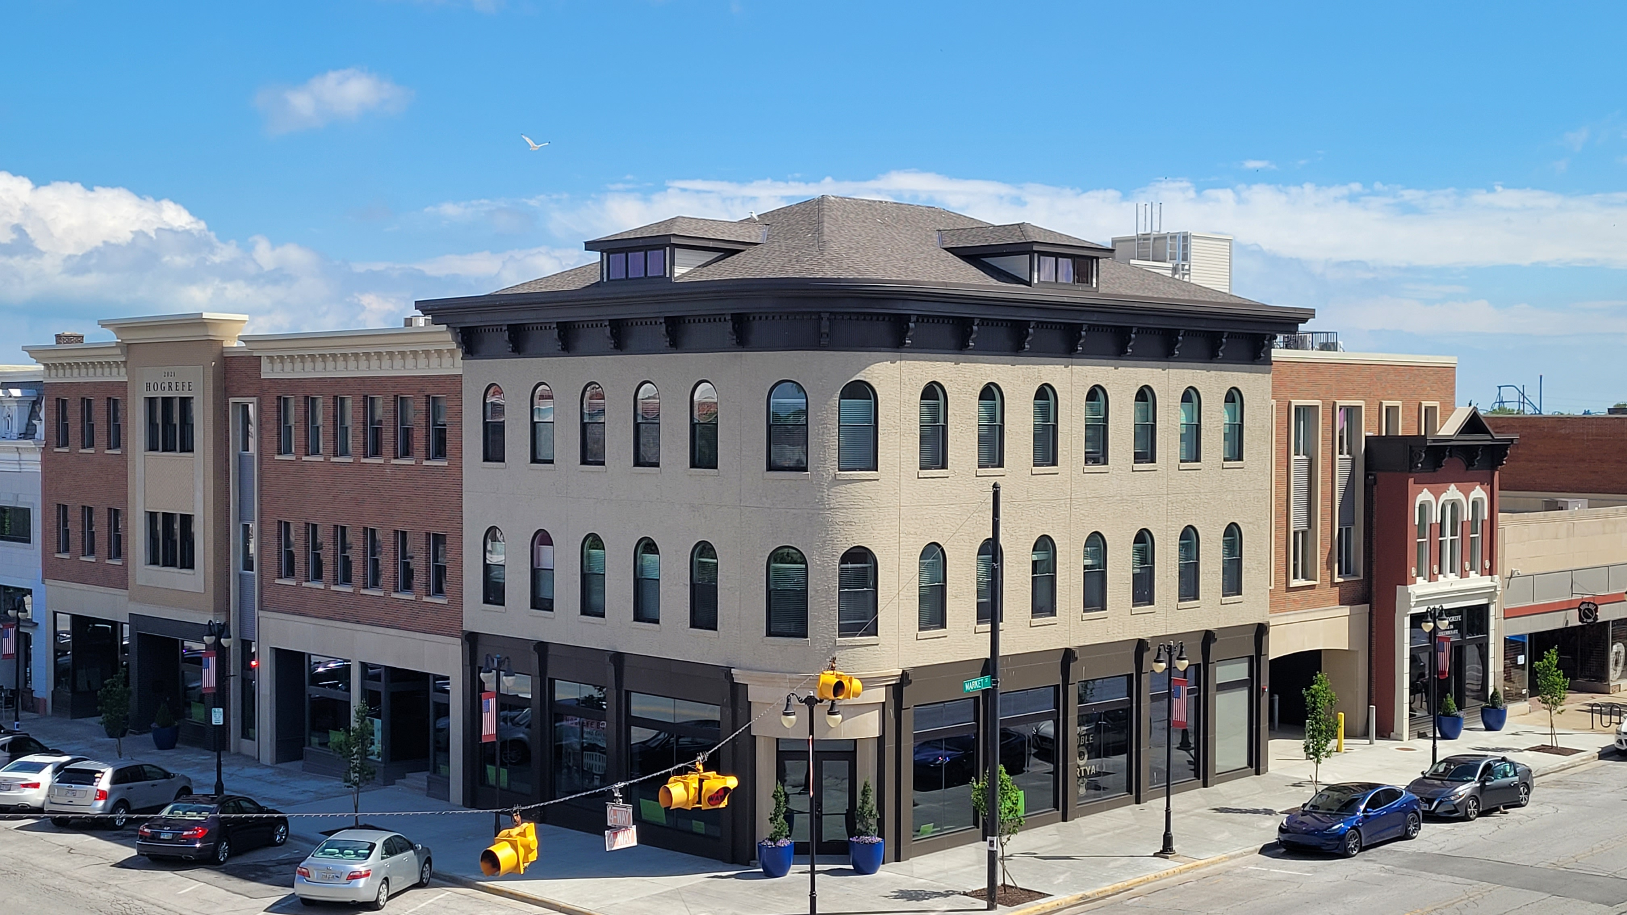
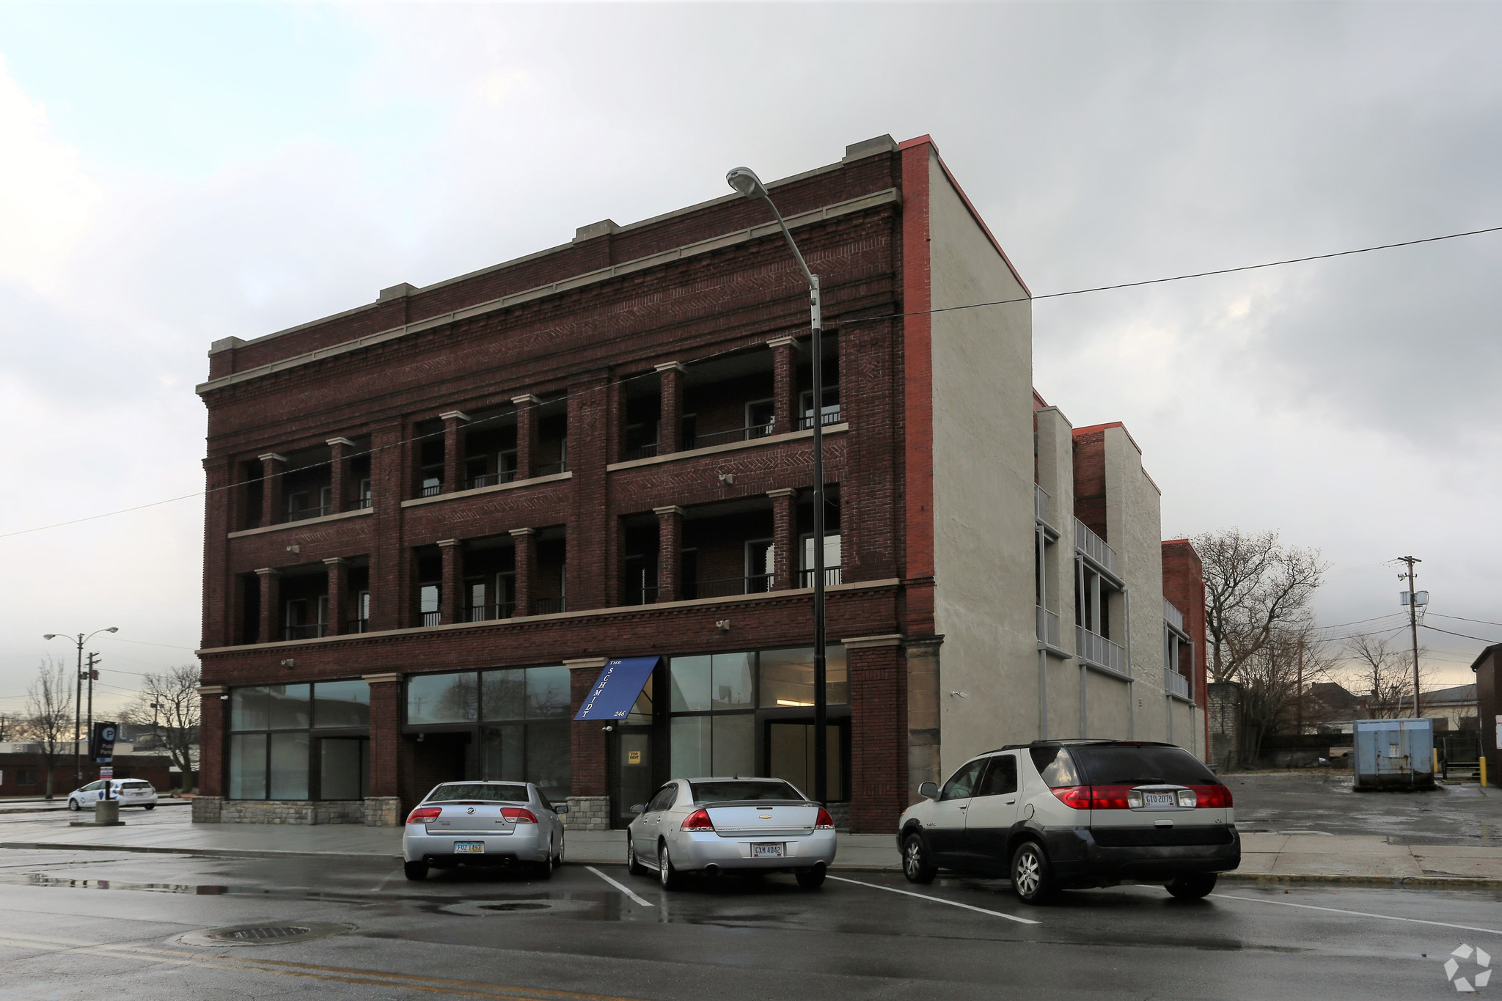
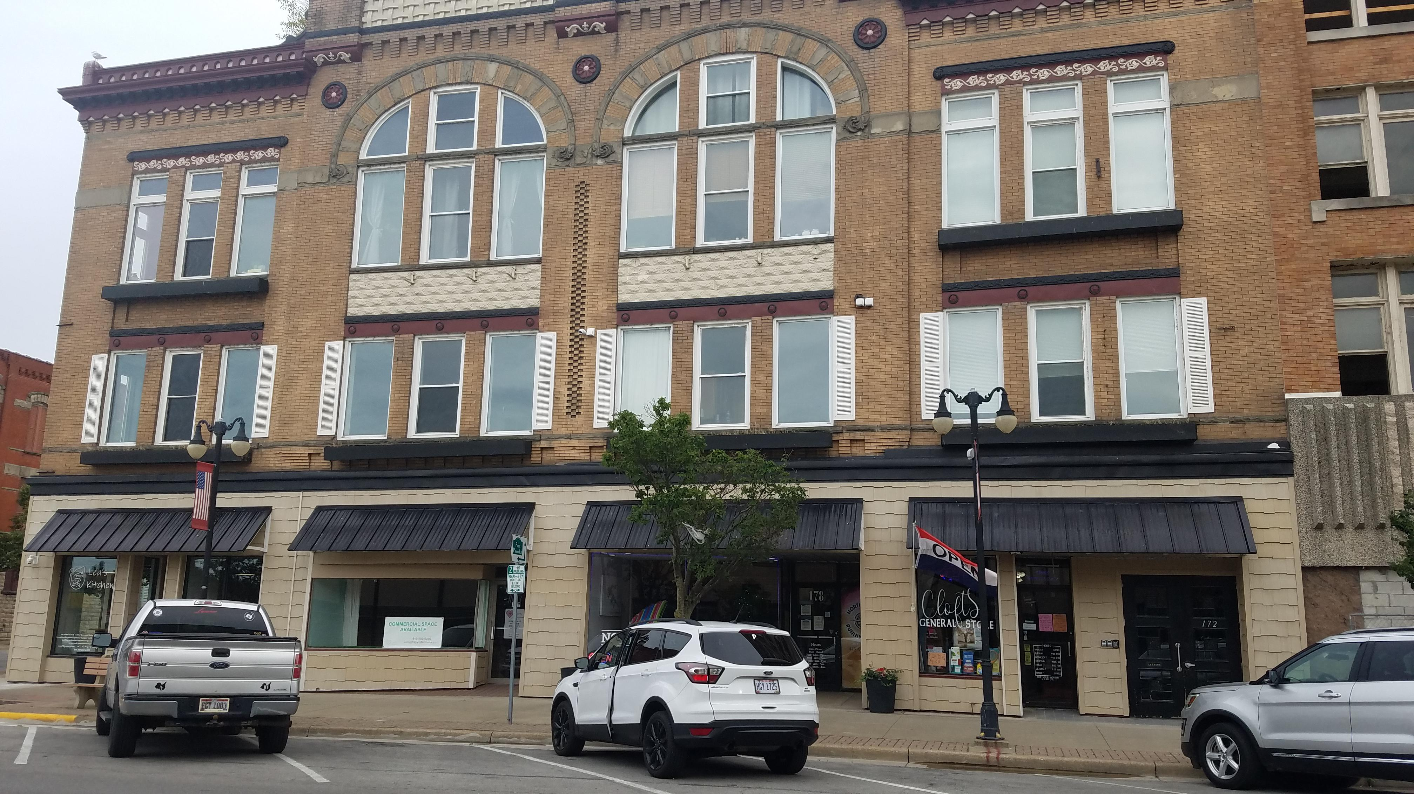
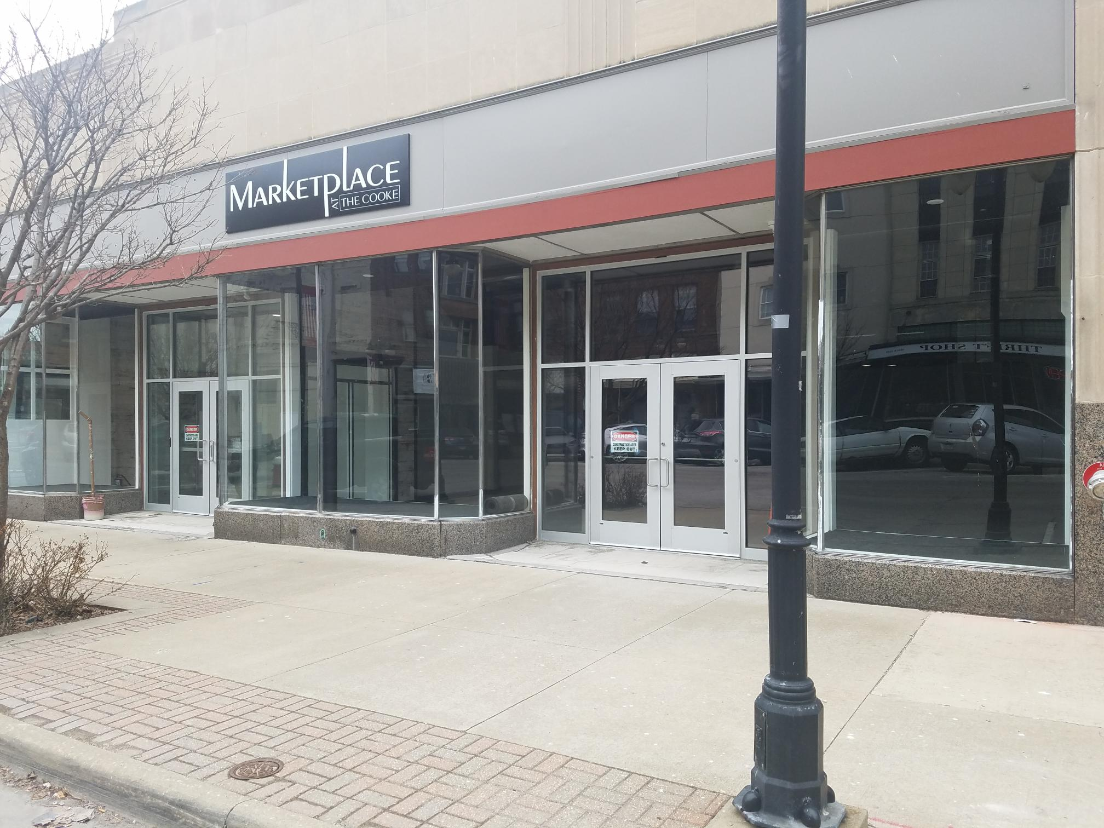
COMMERCIAL Properties AVAILABLE DOWntown SANDUSKY h2 property management 419-502-0200
The Hogrefe Building
156 Columbus Ave
3 Spaces
The Schmidt Building
246 E. Market St
3 spaces
The Lea Building
172 E. Market St
1 spaces
Marketplace Downtown 133 E. Market Street
3 Spaces

Slide 4
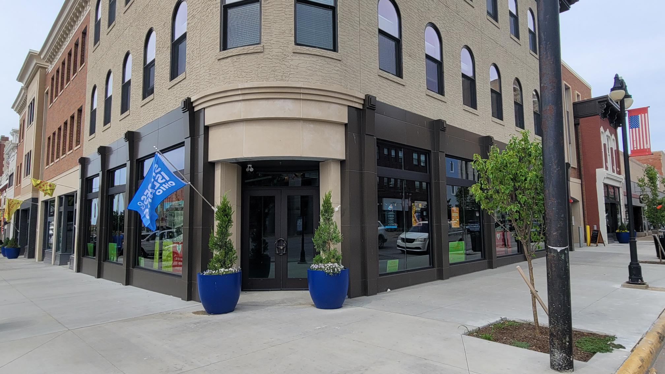
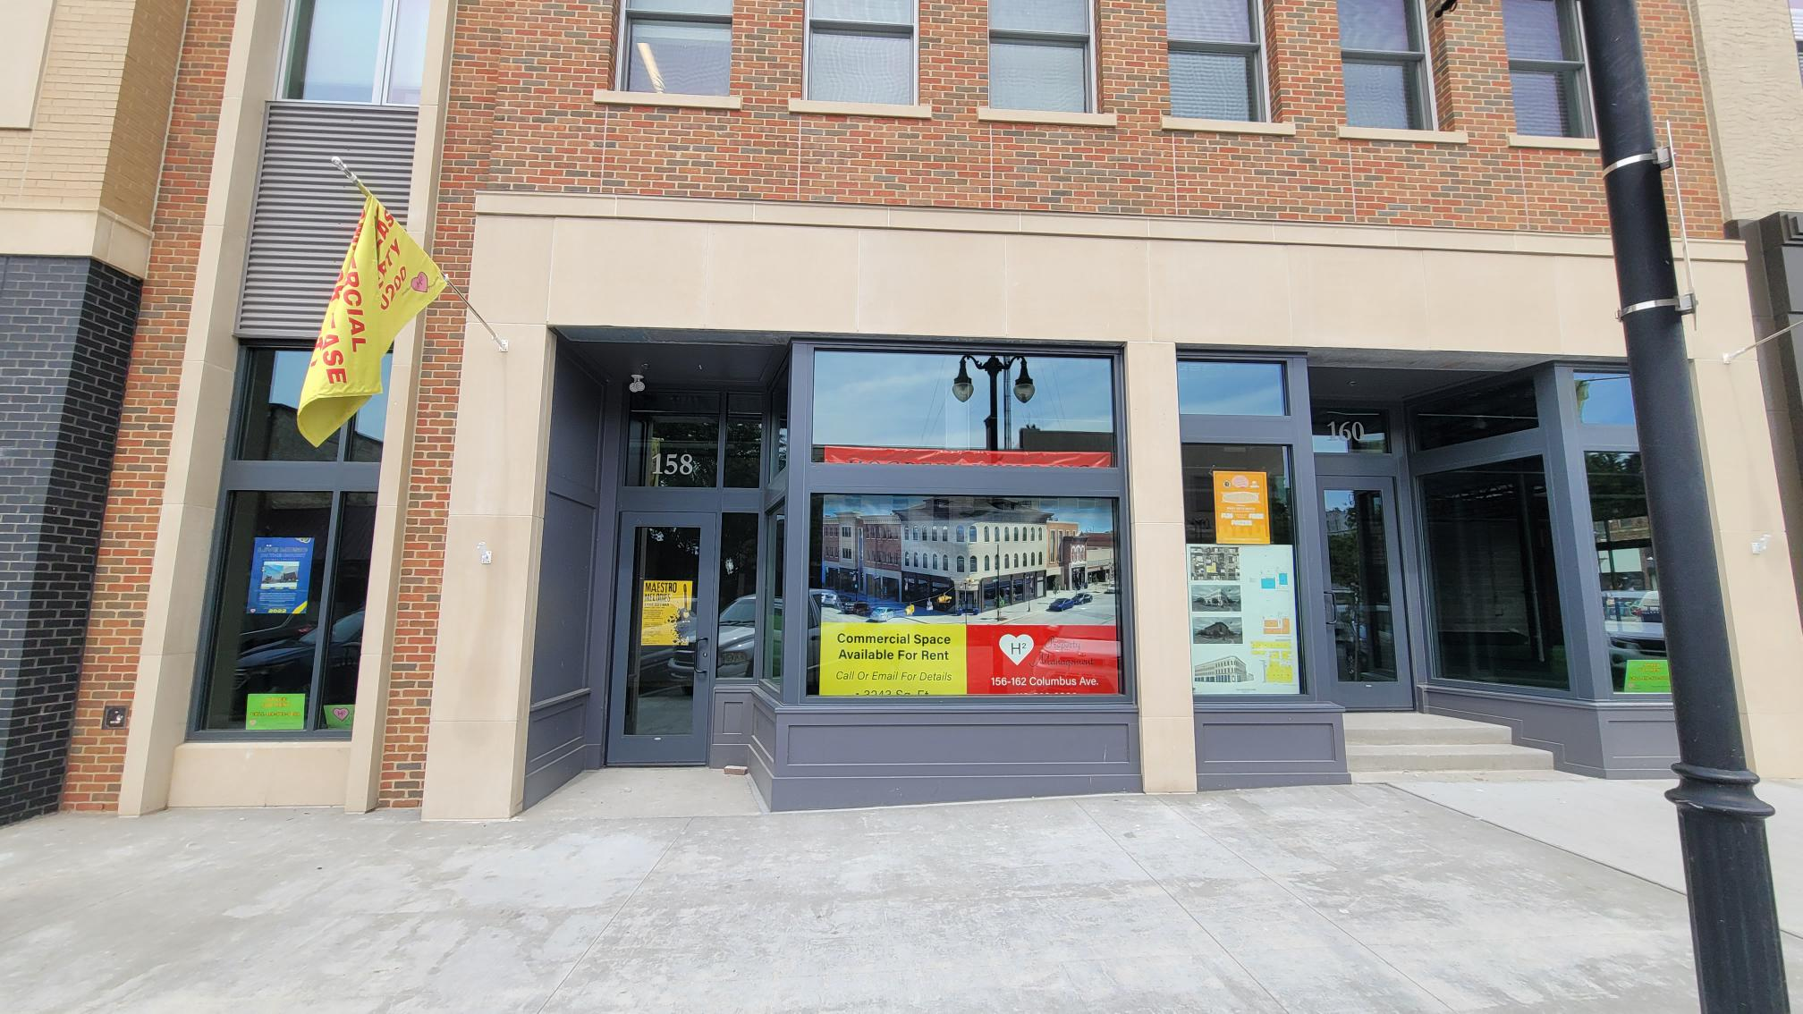
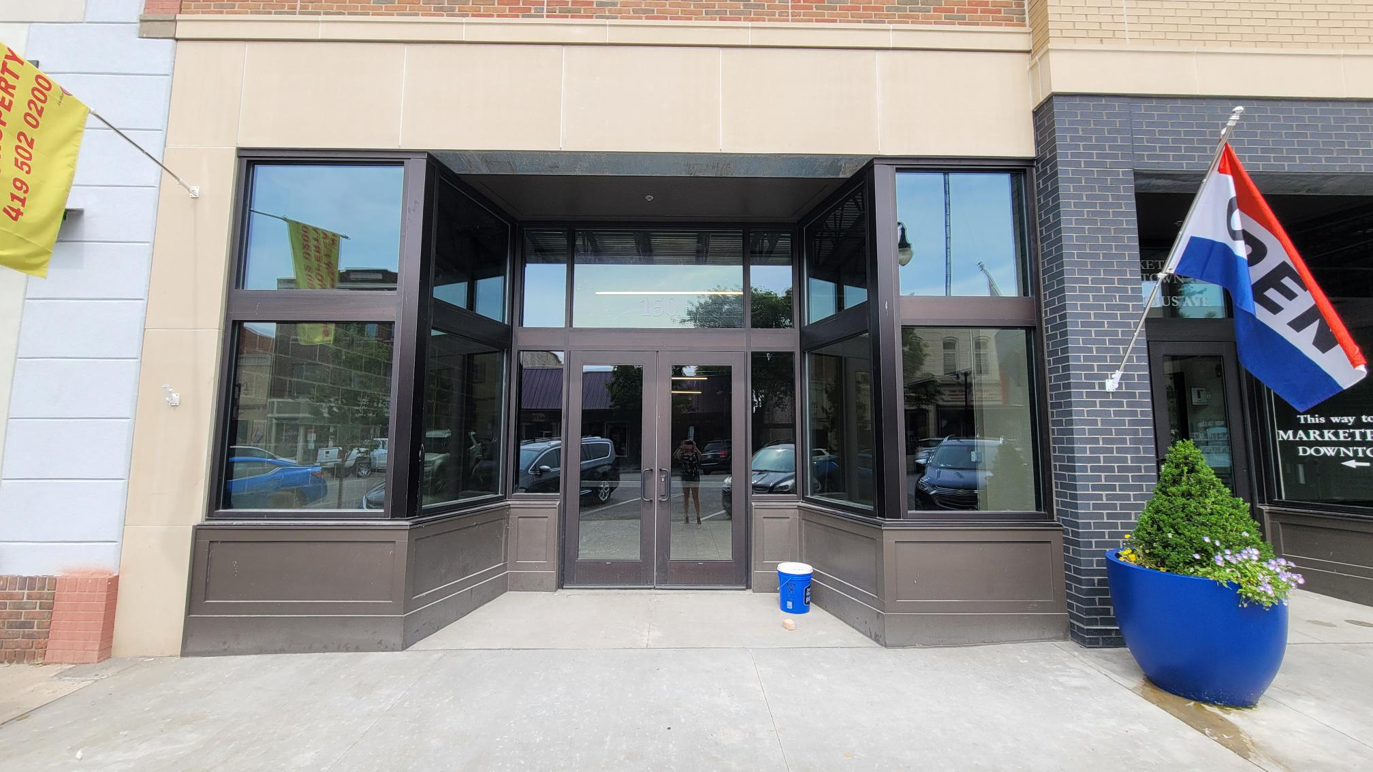
THE Hogrefe building at 156 Columbus Ave 1st Floor Retail space
7090 sf rentable space
Currently designed into 4 separate spaces. Can combine spaces. All front facing spaces on Columbus Ave, the most valuable store frontage in downtown. Great location for your Restaurant, Office, Retail or Entertainment Venue.
3243 sf
1027 sf
1950 sf
874 sf (interior space) - Rented
160-162 Columbus Ave. This corner space is ideal for a restaurant, retail or an entertainment venue -3243 sf
158 Columbus Ave. great
Location in the heart of downtown. -1027 sf
150 Columbus Ave. Perfect location and connected to the Marketplace Downtown -1950sf

Slide 5
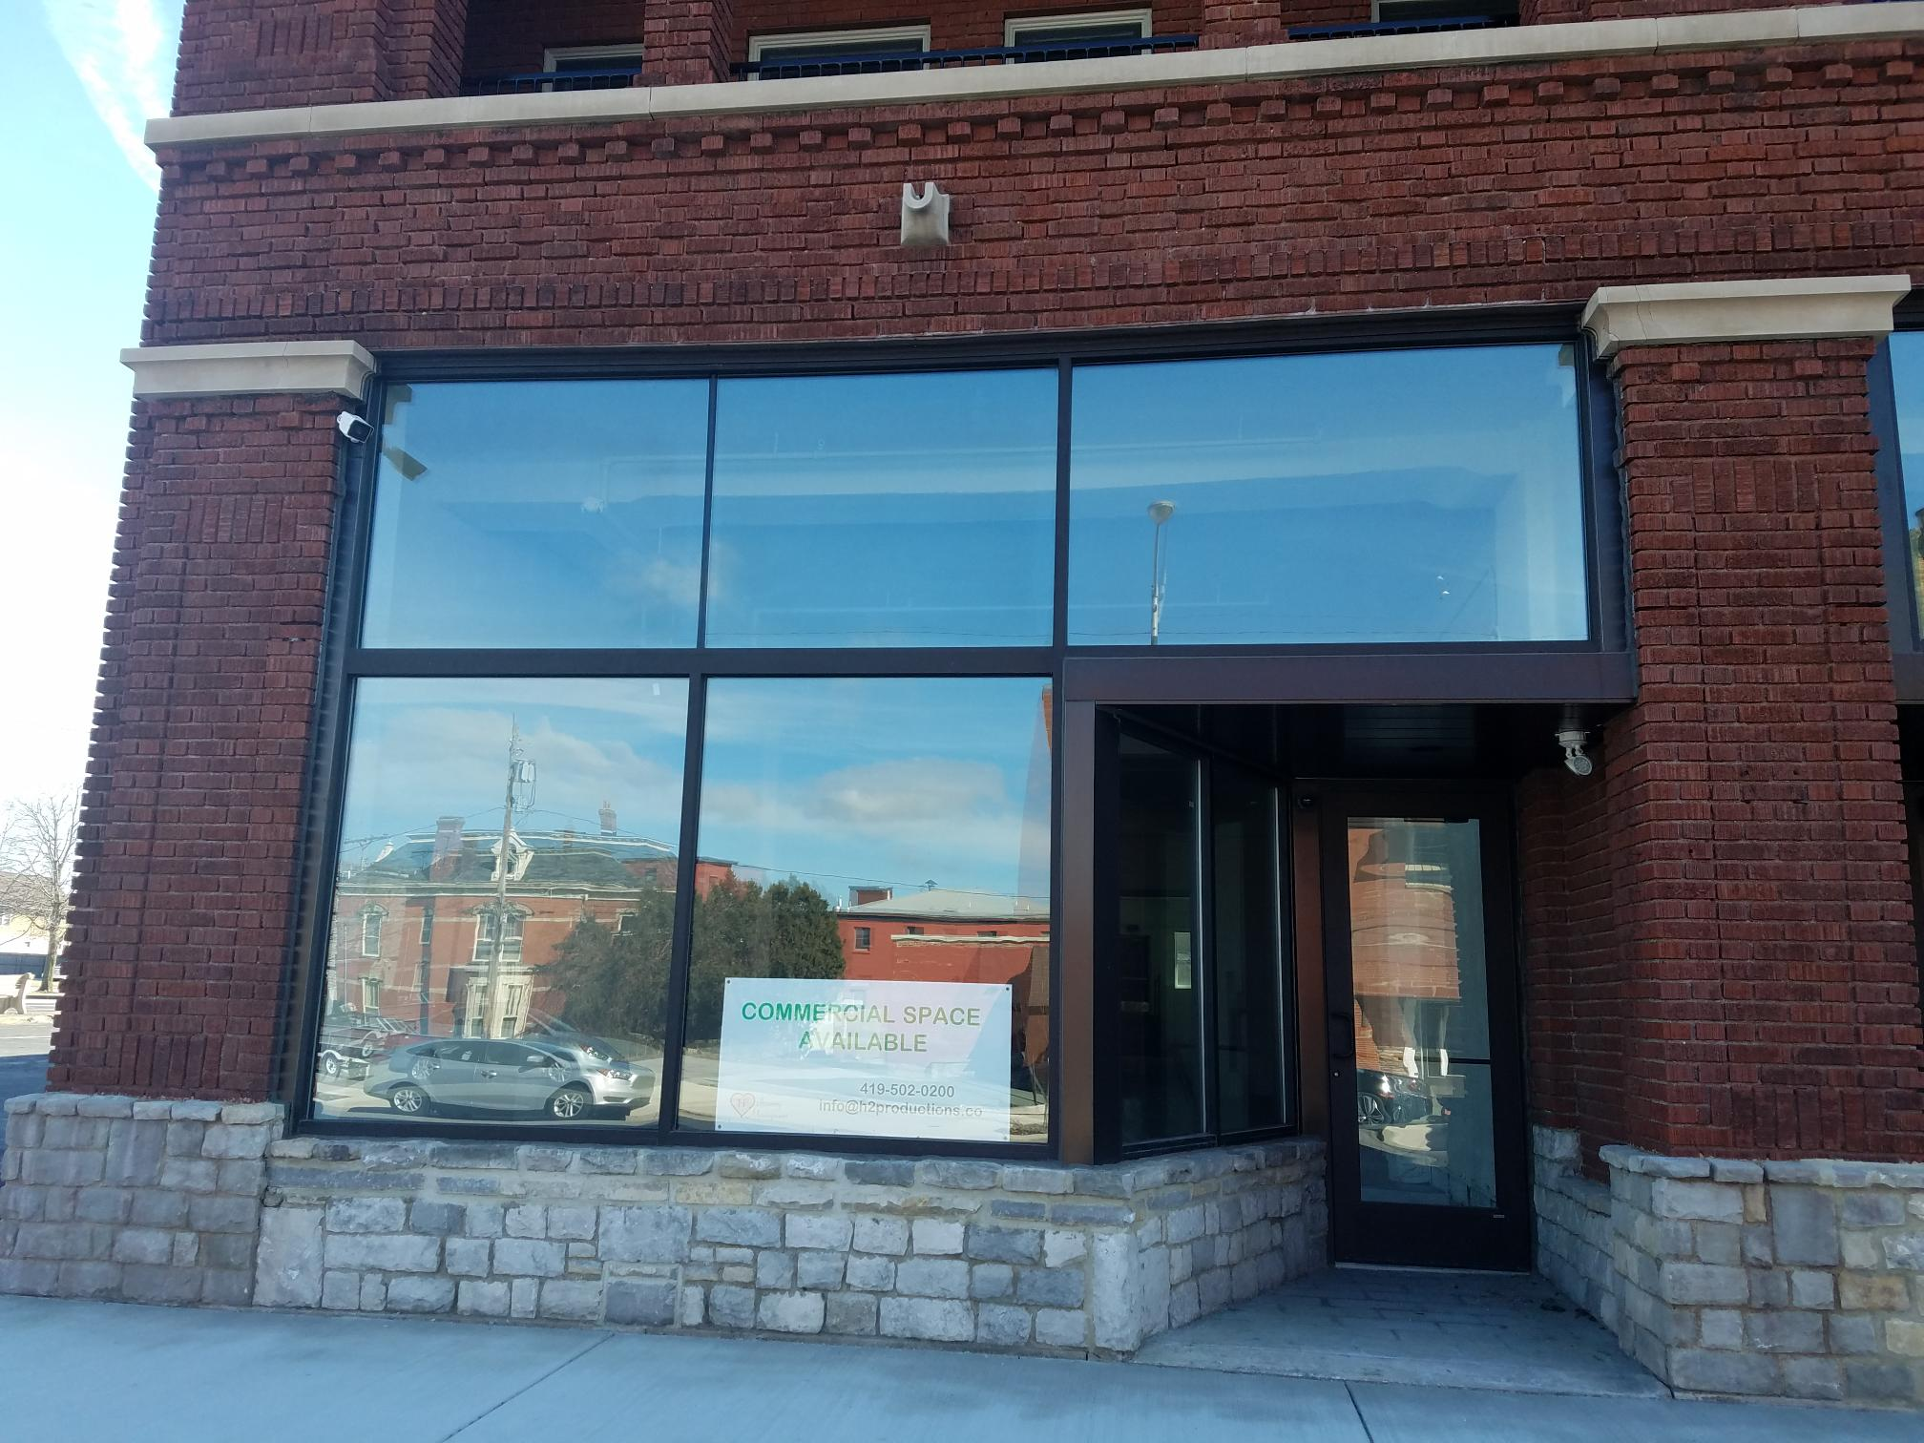
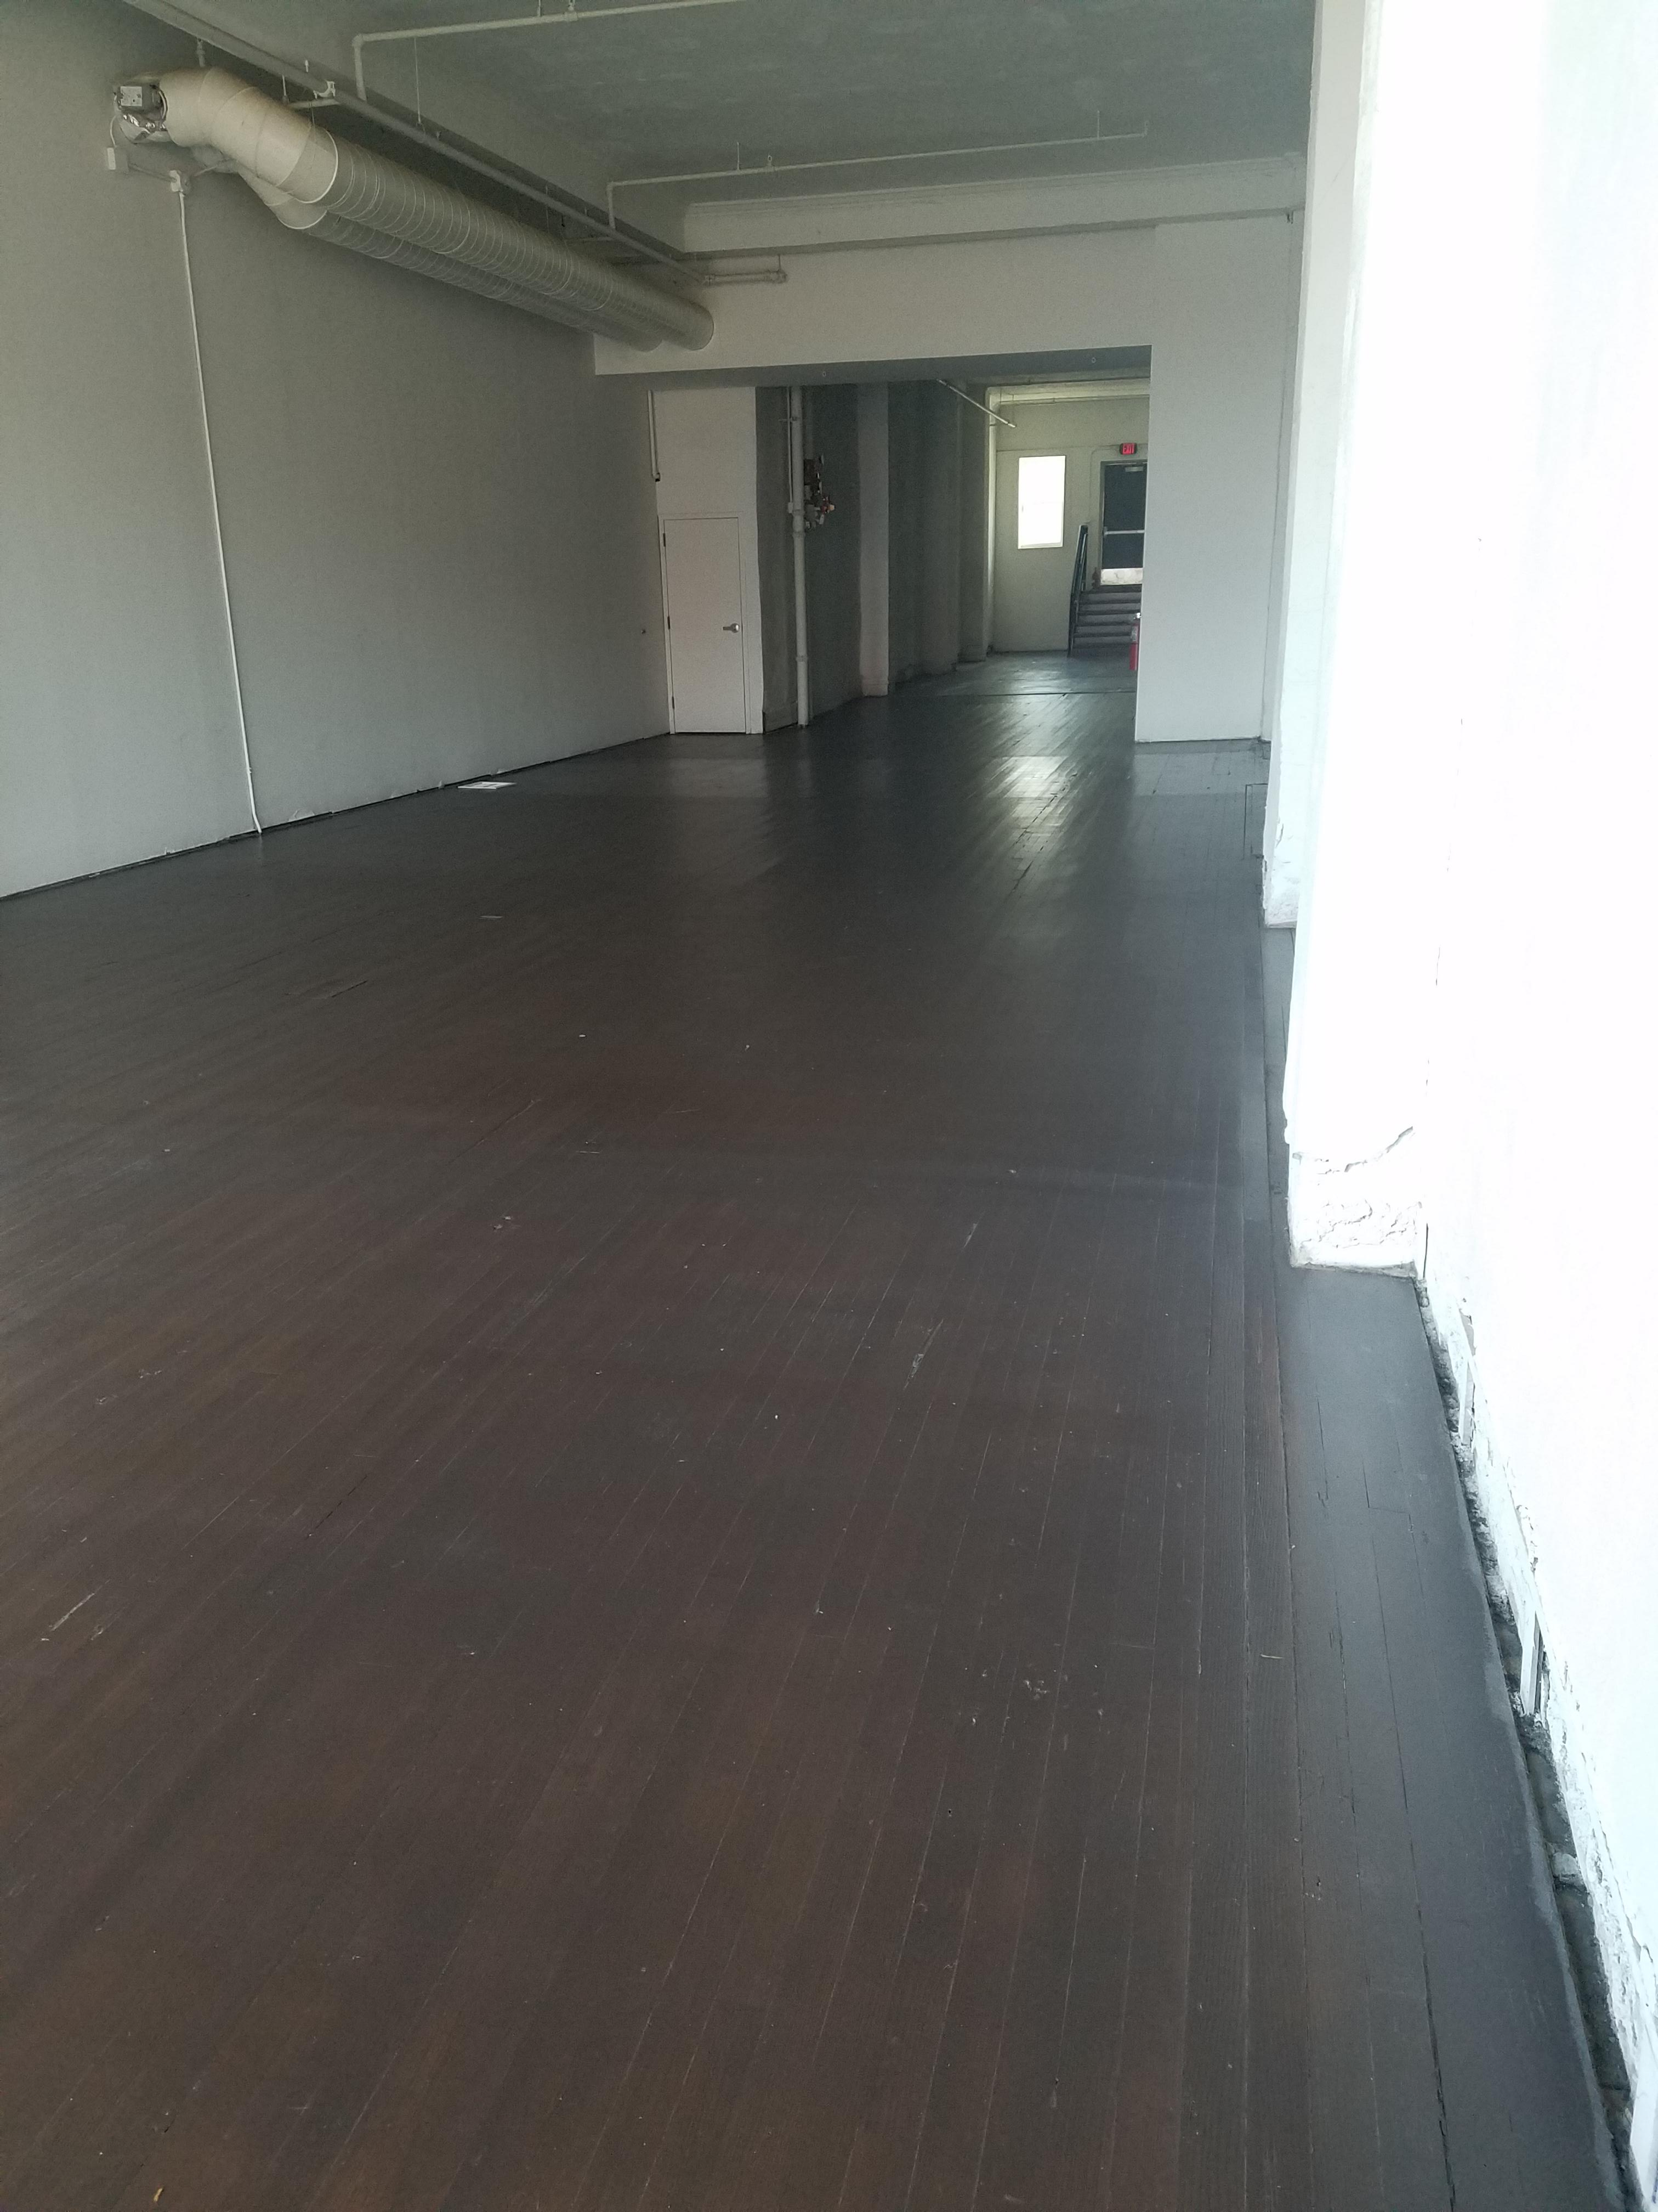
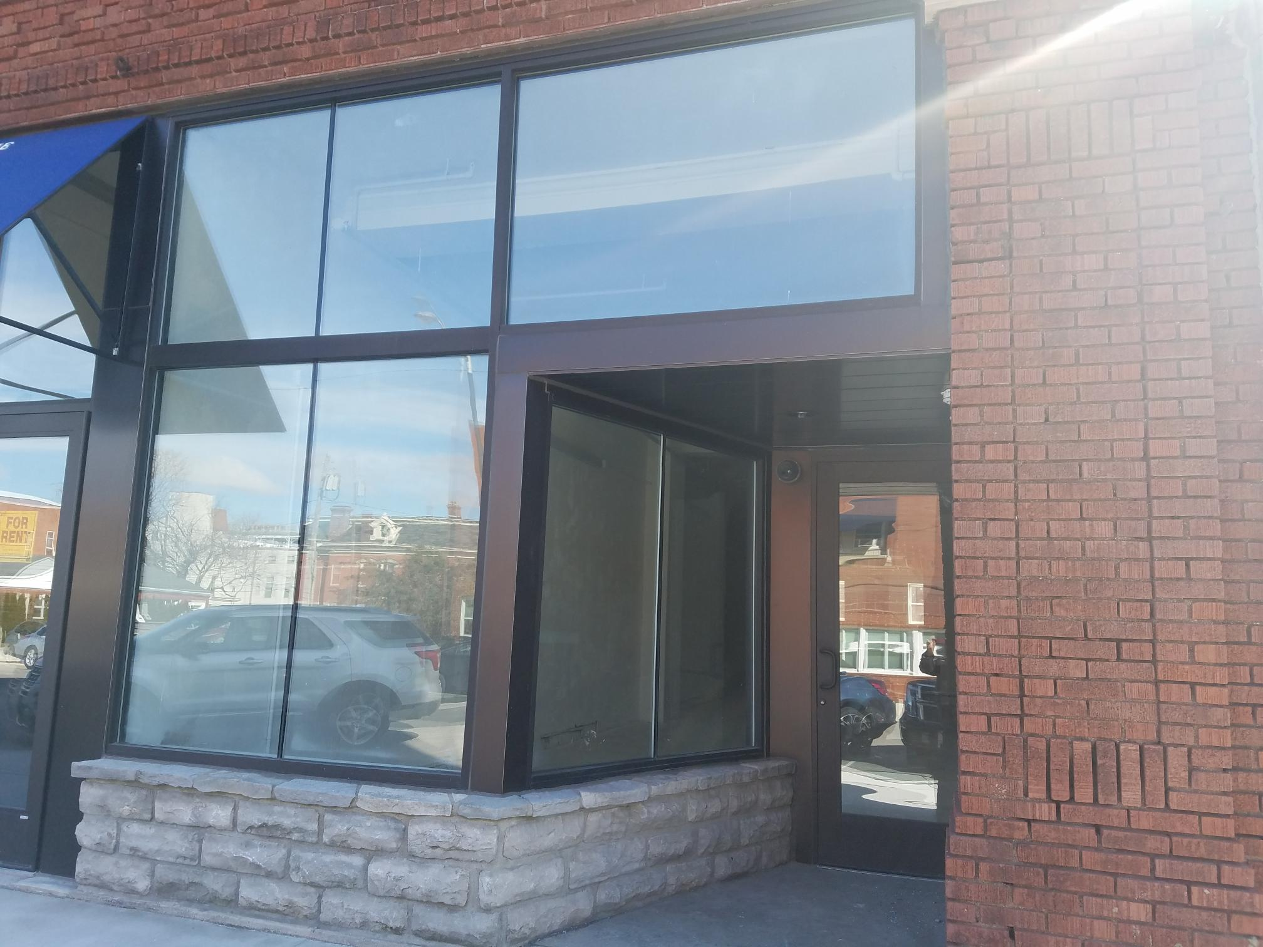
The Schmidt building 246 E. Market Street
6366 sf rentable space
Currently designed into 3 separate spaces. Two or more spaces can be combined
2110 sf
2069 sf
2187 sf
This is an undeveloped retail/office location. Prime location next to the BGSU/Falcon Point Lofts Apartments, 1 block from the Marketplace Downtown and Hogrefe Building and just 2 blocks from Jackson St. Pier.
Suite 1- 2110 sf
$14 sf/yr. plus NNN
Suite 2- 2069 sf
$14 sf/yr. plus NNN
Suite 3- 2187 sf
$14 sf/yr. plus NNN

Slide 6
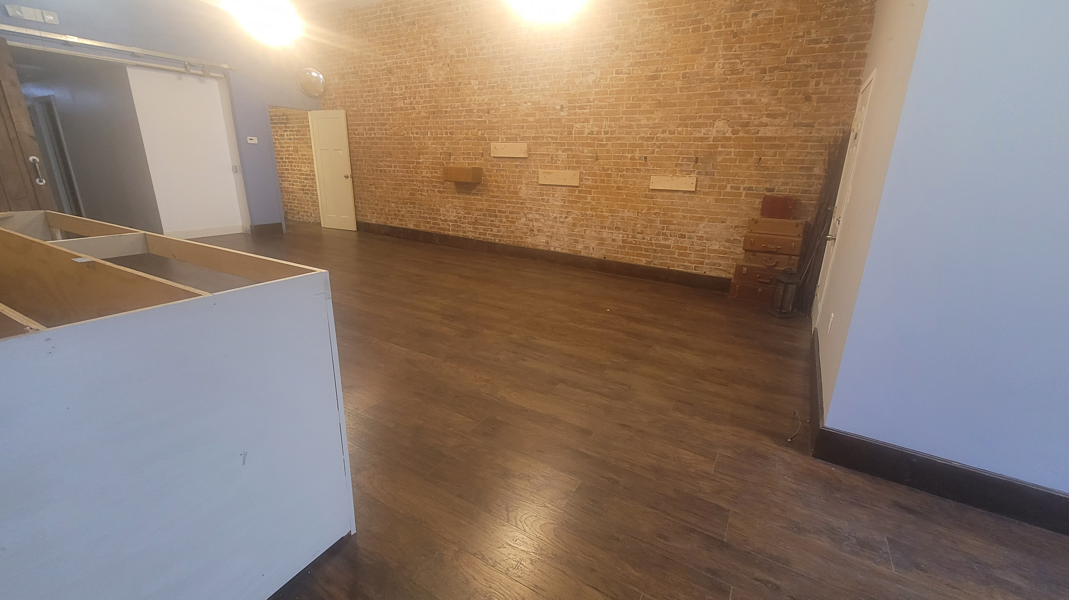
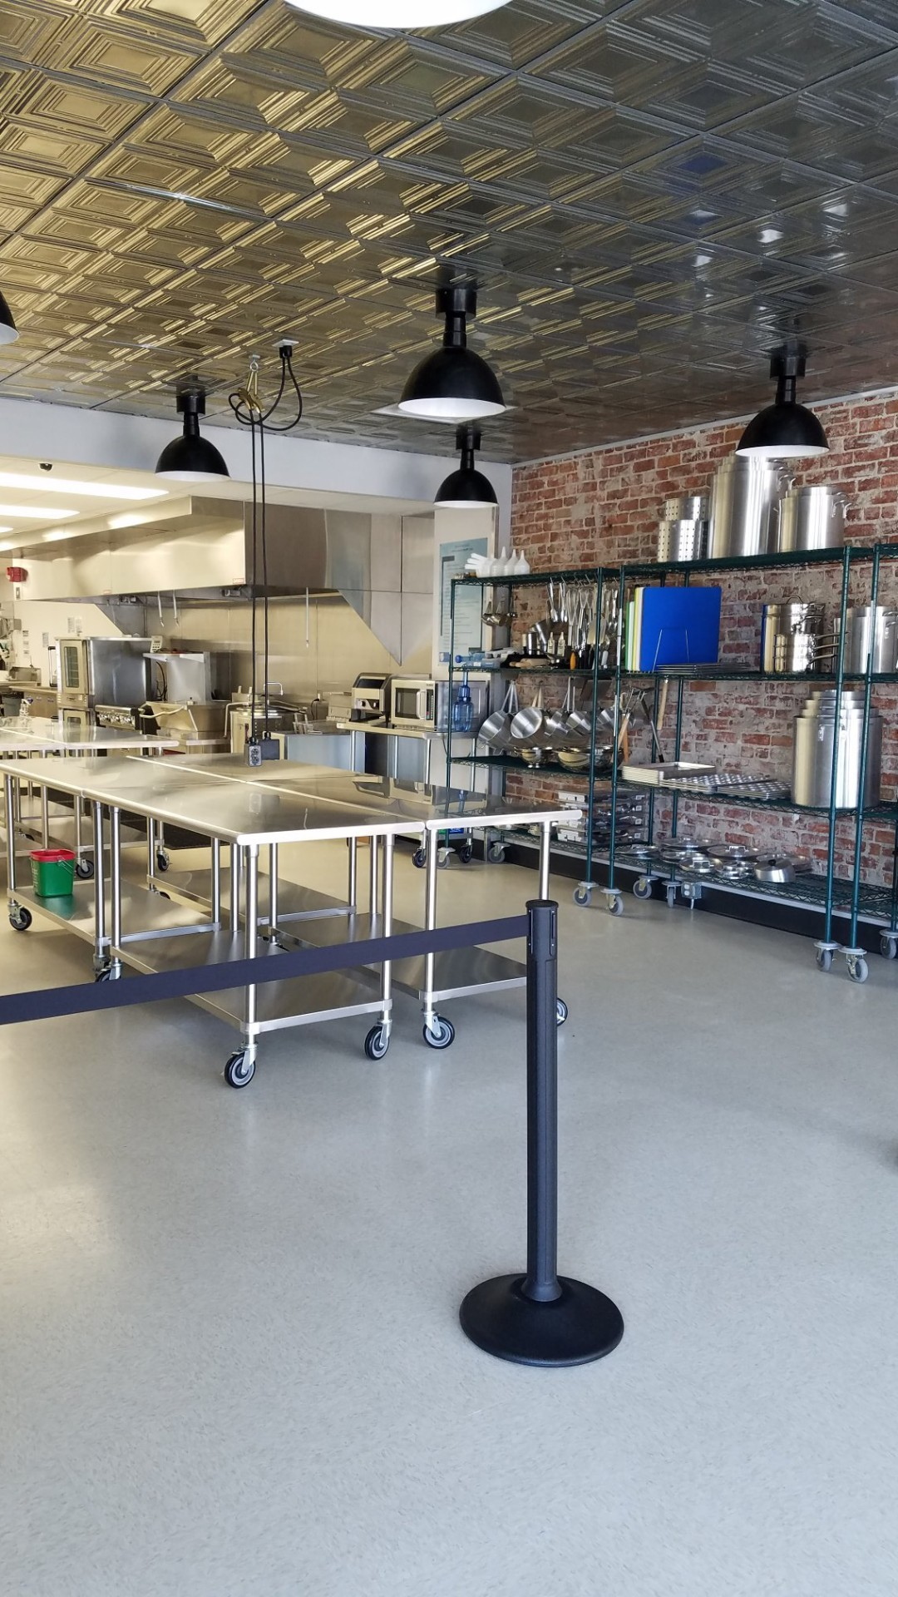
The Lea BUILDING 172 E. Market Street
A beautiful historic and urban feel, these store front locations are perfect for any retail/office space. Located beneath the soon to be Feick Apartment Building and 1 block from the Falcon Point Lofts, so many people, so much foot traffic.
You are across the street from the Marketplace Downtown and The Hogrefe Building.
174 E. Market Street 1450 sf
Street level/great store front location
$12 sf/yr. plus NNN
Opening in 2024
182 E. Market Street 1527 sf
Street level/ great store front windows
$14 sf/yr. plus NNN
Rented
Lea’s Kitchen Co Shared commercial Kitchen available to rent hourly or lease full kitchen.
Rented

Slide 7
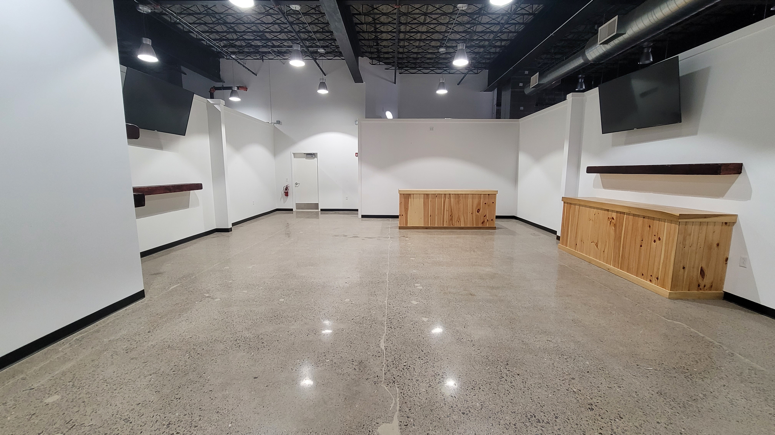
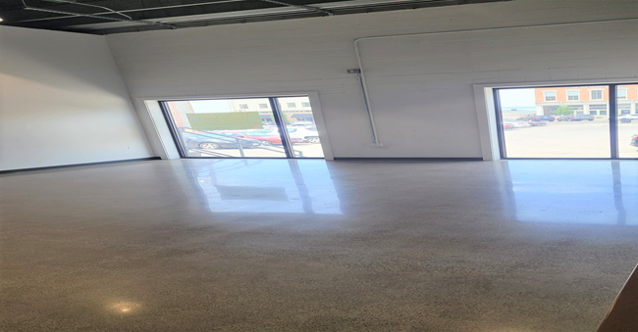
The Marketplace Downtown
133 E. Market Street
An indoor Shopping Experience in Downtown Sandusky
Located in the heart of downtown Sandusky this indoor retail space will have a mix of local shops, food and entertainment. Families can enjoy this location for all activities.
EAT*DRINK*SHOP*PLAY.
1007 sf center space
$12 sf/yr. plus NNN
Directly across from Noble Axes
587 sf -window space
$14 sf/yr. plus NNN
Rented

Slide 8
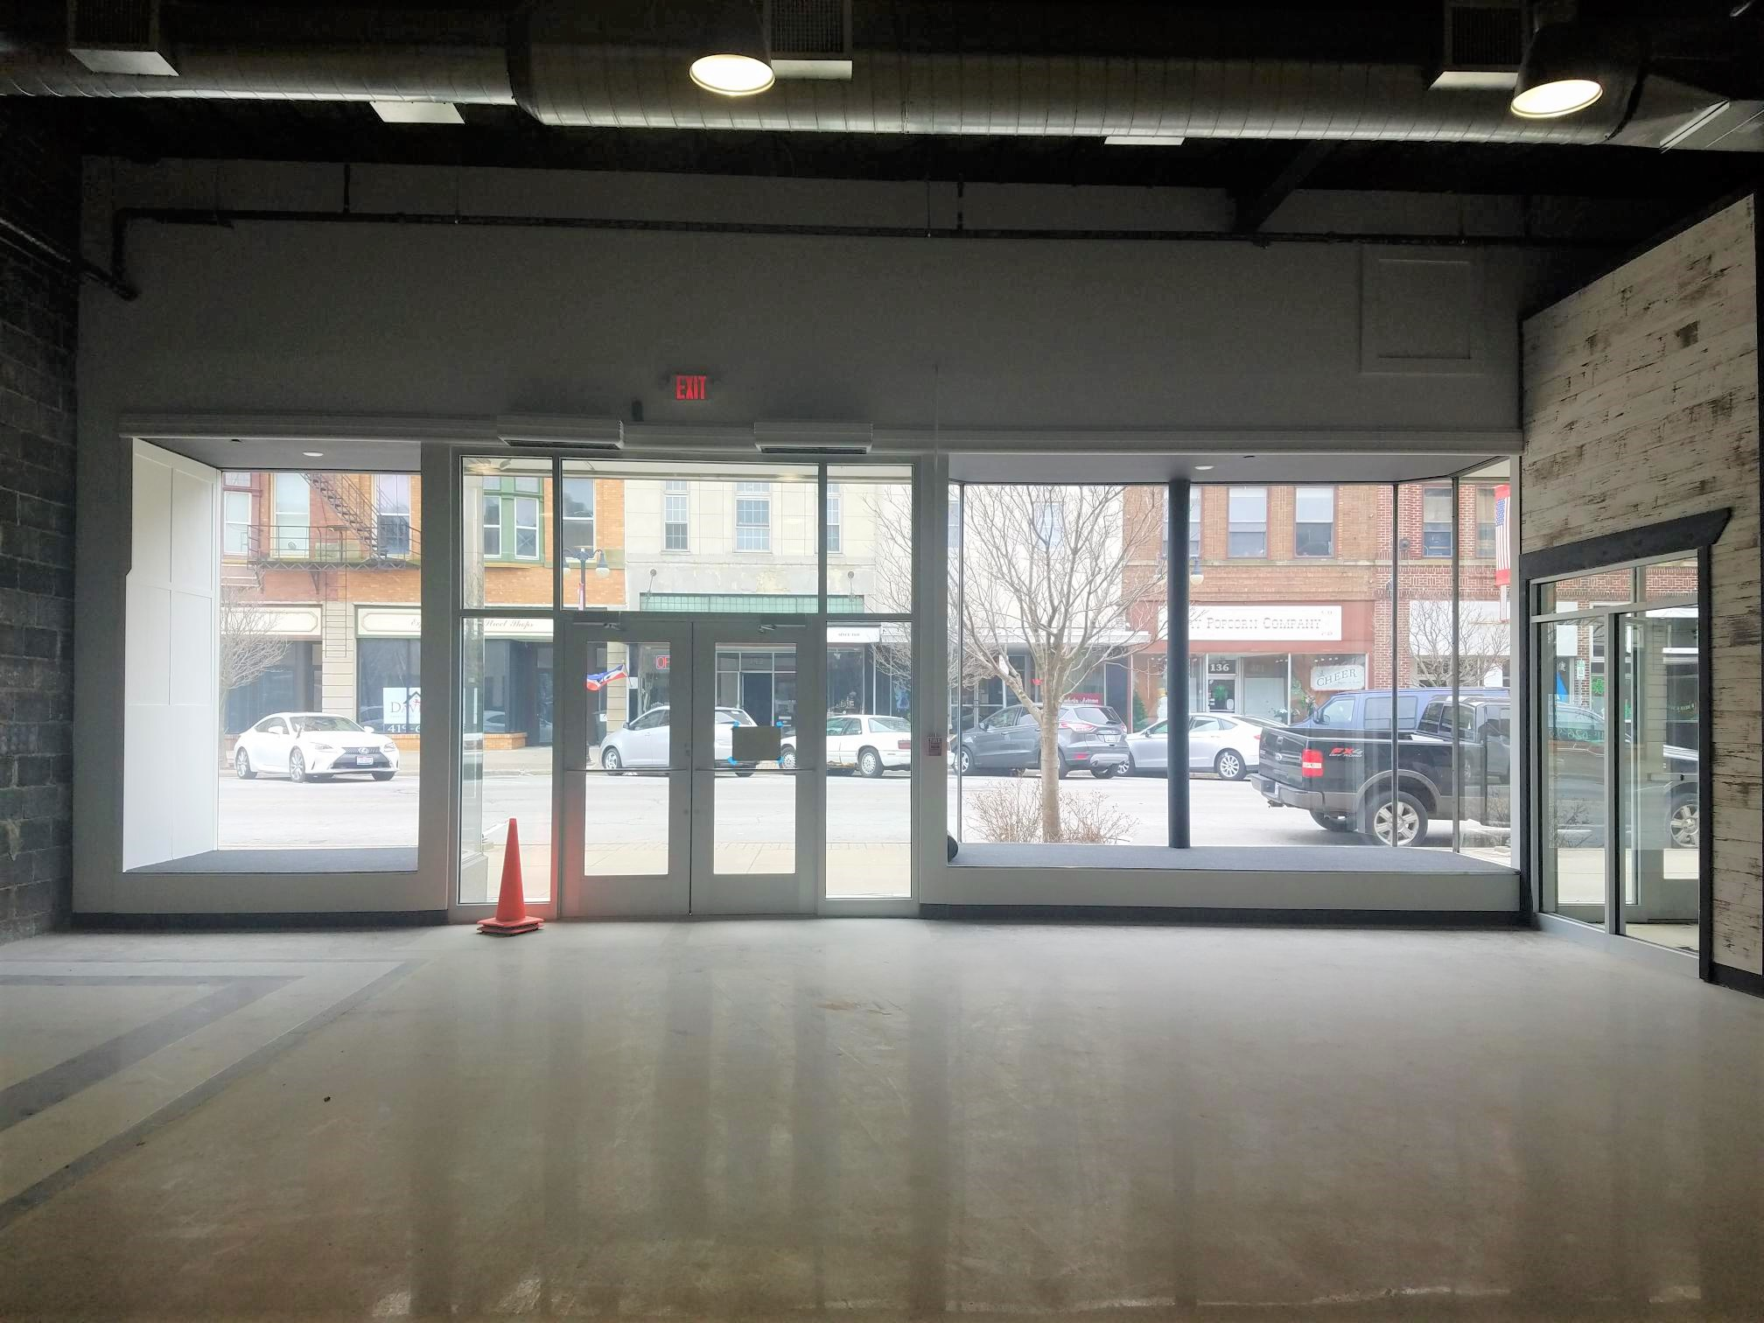
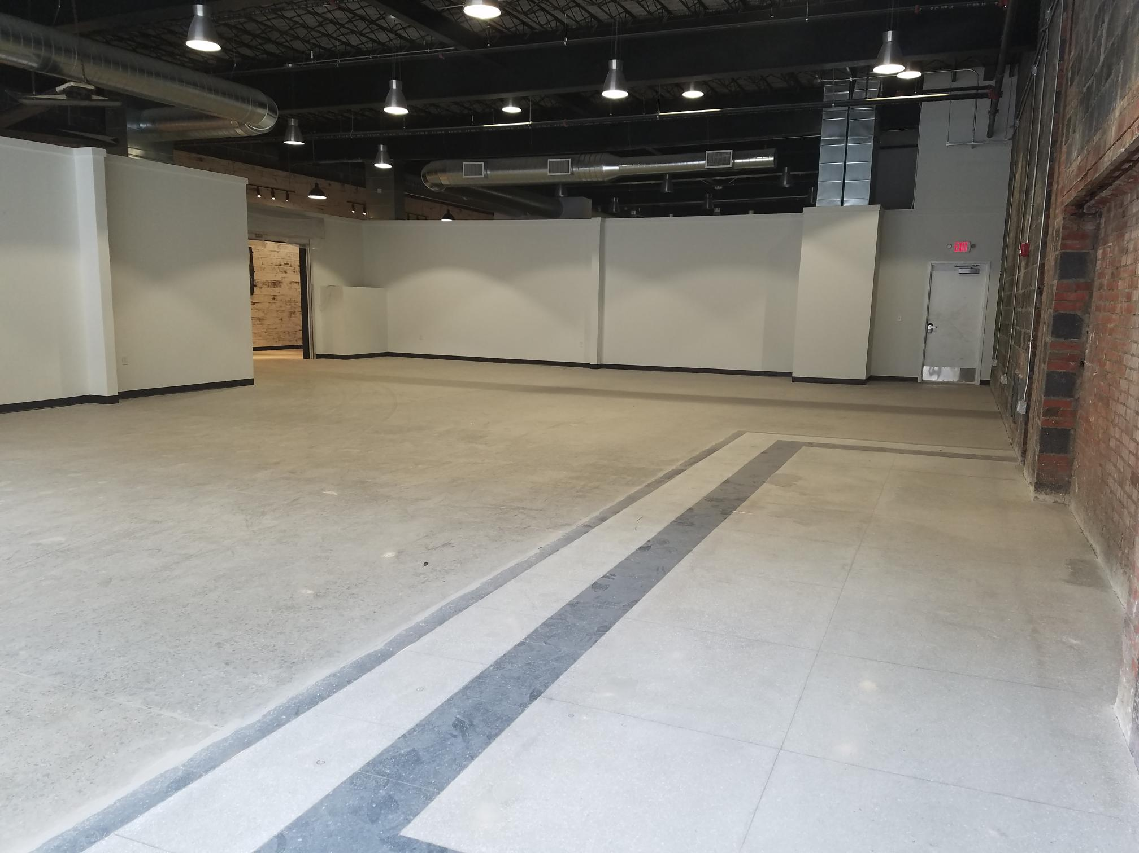
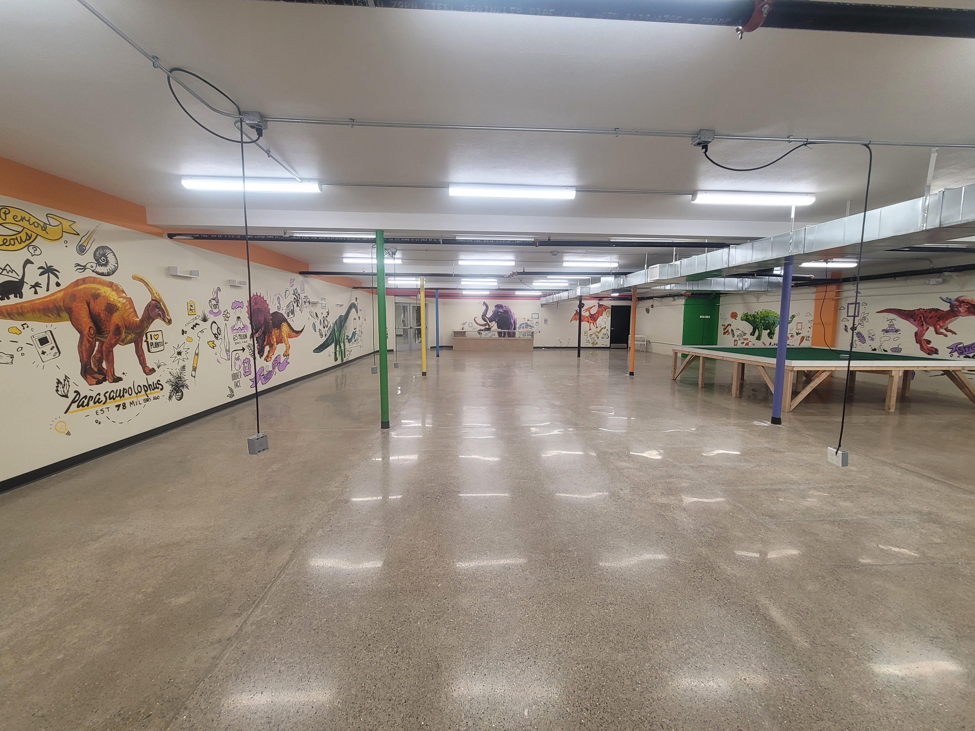
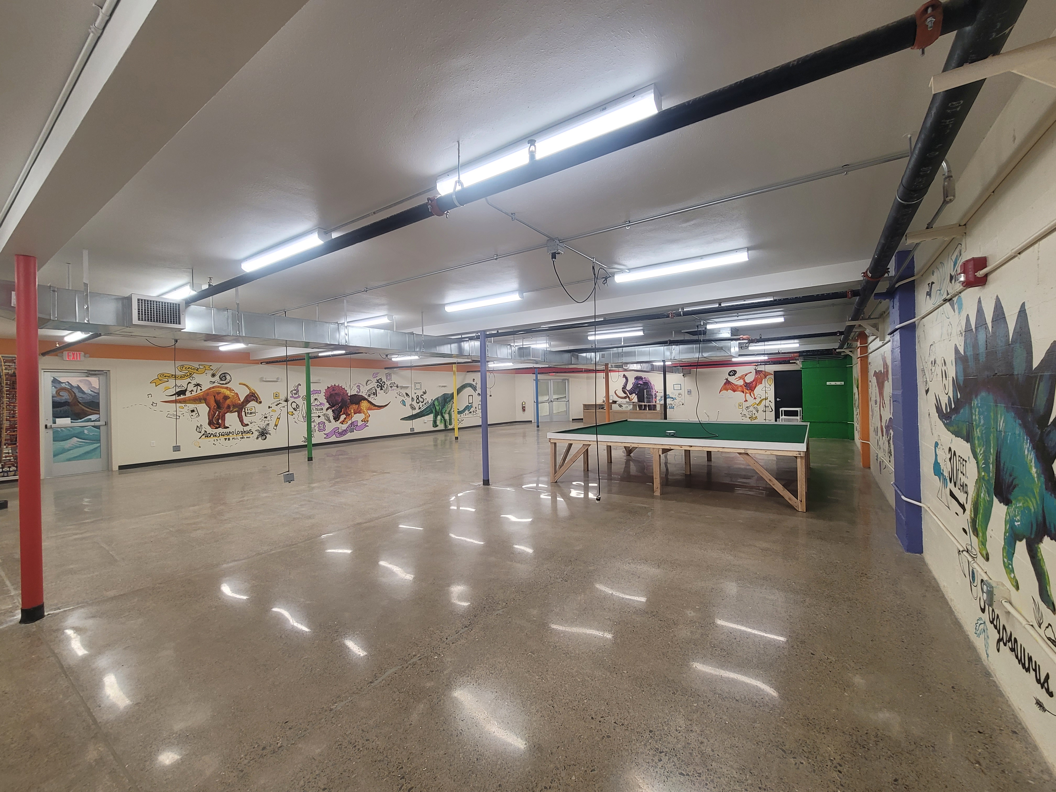
The Marketplace Downtown
133 E. Market Street
opening early 2024.
An indoor Shopping Experience in Downtown Sandusky
Located in the heart of downtown Sandusky this indoor retail space will have a mix of local shops, food and entertainment. Families can enjoy this location for all activities.
EAT*DRINK*SHOP*PLAY.
The street level 2259 sf space
Lower level approx. 2000 sf space

Slide 9
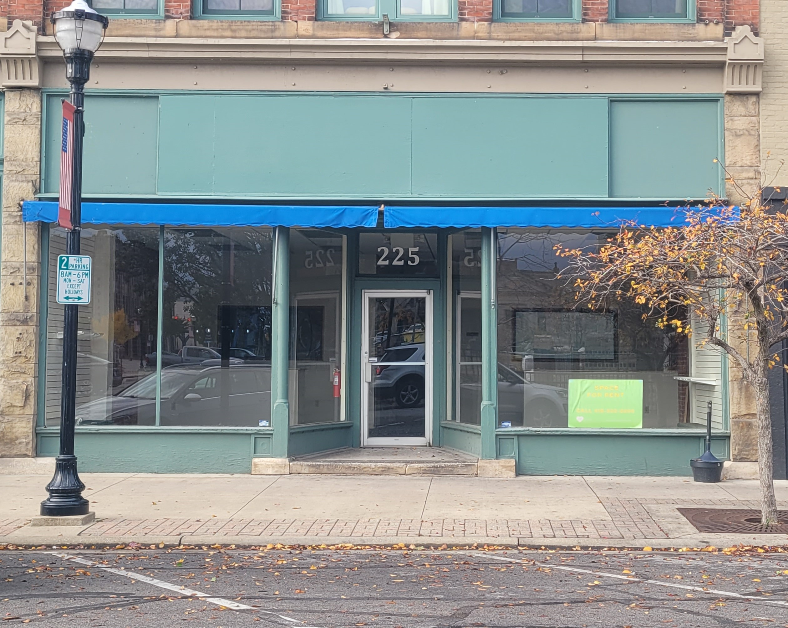
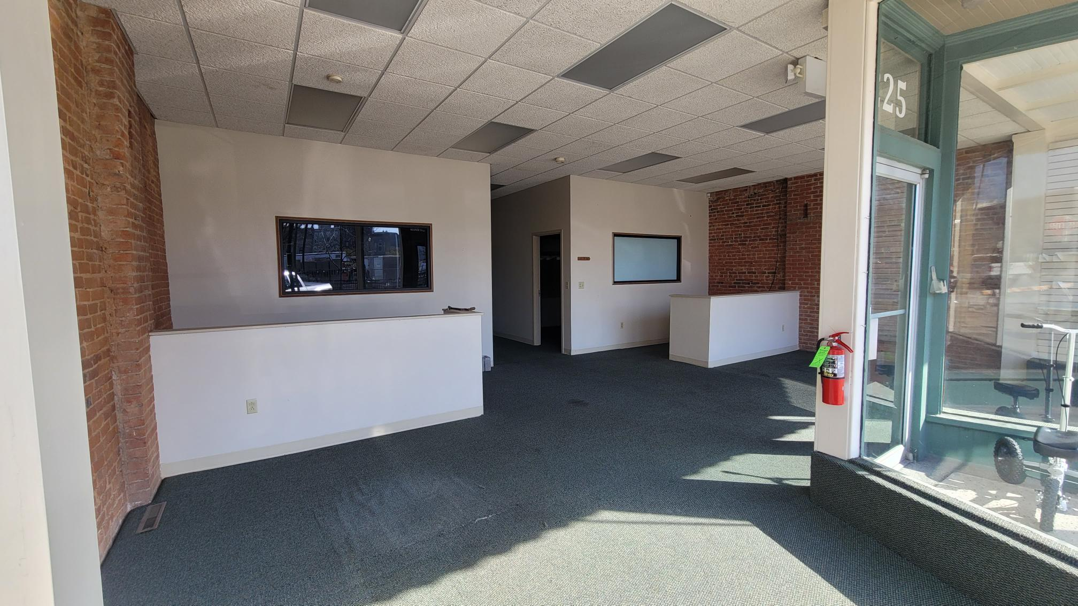
Shoreline Building
225 W. Water Street
Great location downtown on Water Street, across from the
State Theater, Next to the Hotel Kilborne 1block from Jackson Street Pier.
1027 sf window front location
$16 sf/yr. plus NNN

Slide 10
RentAL Terms contact h2 Property Management-419-502-0200
Hogrefe Building 156 Columbus Ave
$19/sf Base Rent
Includes $50/sf Tenant Improvement credit
More improvement money available
Triple Net and Utilities
NNN expenses estimated at $0.40/sf/month.
10 and 20 year leases available
Shorter leases possible
Shoreline Building 225 W. Water Street
$16/sf Base Rent
Includes $10/sf Tenant Improvement credit
More improvement money available
Triple Net and Utilities
NNN expenses estimated at <$0.40/sf/month.
5-10 year leases available
longer leases possible

Slide 11
Rental Terms contact h2 Property Management-419-502-0200
Schmidt Building 246 E. Market St
$14/sf Base Rent
Includes $10/sf Tenant Improvement credit
More improvement money available
Triple Net and Utilities
NNN expenses estimated at <$0.40/sf/month.
5-10 year leases available
longer leases possible
Lea Building 172 E. Market St
$12-14/sf Base Rent
Includes $10/sf Tenant Improvement credit
More improvement money available
Triple Net and Utilities
NNN expenses estimated at <$0.40/sf/month.
5-10 year leases available
longer leases possible

Slide 12
Rental Terms contact h2 Property Management-419-502-0200
Marketplace Downtown 133 E. Market St.
Inside the MARKETPLACE DOWNTOWN
$10-$16/sf Base Rent
$10/sf Tenant Improvement credit could be available.
Triple Net and Utilities
NNN expenses estimated at <$0.40/sf/month.
5-10 year leases available
longer leases possible

Slide 13
Contact information
H2 Property Management, LLC
Main Contact: Sharon Salmon
ssalmon@h2productions.co
419-502-0200 office
419-370-1037 cell
152 Columbus Ave. Sandusky, OH 44870
H2 Property Holdings, LLC
Main Contact: Richard Hogrefe, Ph.D.
rhogrefe@H2productions.co
mhogrefe@h2productions.co

Slide 14
Downtown Sandusky Highlights
2019 And 2023 Voted Best Coastal Town in America USA today
Home of Cedar Point (3.7 miles away) more than 3 million visitors a year
Kelly’s Island and Put-In -Bay (ferry access daily)
Canada’s Pelee Island (daily trips)
Goodtime and Jet Express Cruise
Iron Man 2022 & 2023 host city
Jackson Street Pier including the Summer Concert Series
DORA zoned
Neighboring district of the Sports Force Park at Cedar Point Sports Center (3.8 miles away)
Marketplace Downtown- Eat-Drink- Shop-Play all in 1 location.

