Slide 1
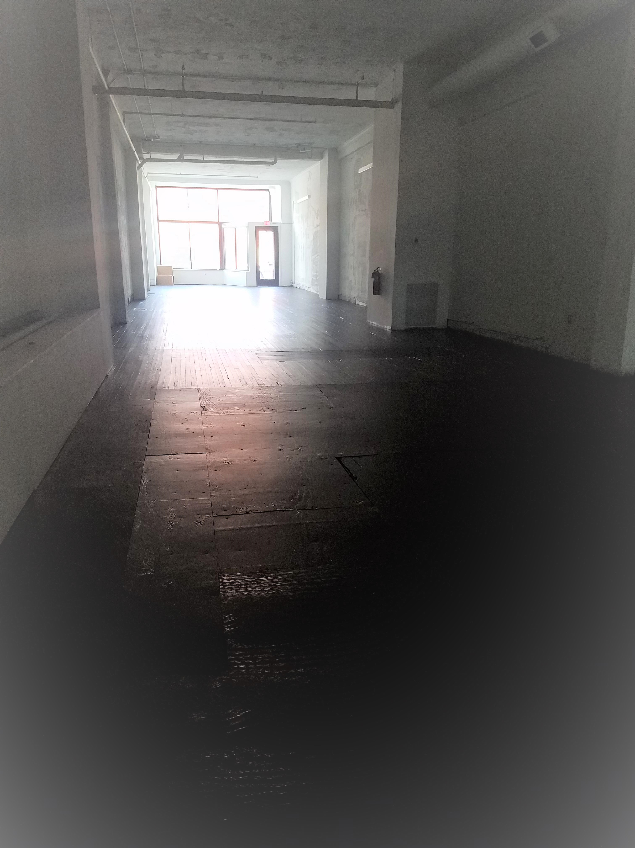
COMMERCIAL SPACE FOR RENT
PRIME LOCATION
HISTORIC DOWNTOWN
STREET ACCESS
GREAT VISIBILITY
$ 14 square foot
Plus NNN
244 E Market St Unit B
Sandusky, OH 44870
1st month is FREE!
Triple Net Lease
Multi-year leases available
Multi use location
Base rent includes $10,000 in tenant improvement credit, plus 1 unisex bathroom (5-year lease minimum)
Additional TI available
Progressive Management
This undeveloped retail/office space is located in Downtown Sandusky in a beautiful building. Located on Market Street you are within a block of Columbus Avenue the center of the city’s heart, making it a perfect location for any sort of enterprise. It has street level access. The floors above are higher end residential rentals, adding to the prestige of the location. It has a layout that is amenable retail or office use.
H2 Property Management
Sharon Salmon
Office:419-502-0200
Cell: 419-370-1037
Email: Ssalmon@h2productions.co
Office: 222 Shoreline Dr
Rear Office
Sandusky, OH 44870
Hours: 8-4:30 M-F Other by Appt
1 – Rental rate over the term of the lease will be adjusted if additional TI is requested.
Size:
Bathrooms:
Street Access:
TI Available: (Tenant Improvements)
Customized in Commercial Lease
Street
Central
Gas Furnace
Immediate
2069 sf
No
Yes
Parking:
Air:
Heat:
Availability:
H2 Property Management is part of the H2 Productions Family of Companies
For Love, With Love, Sandusky. Our Town, Our Future

