Slide 1
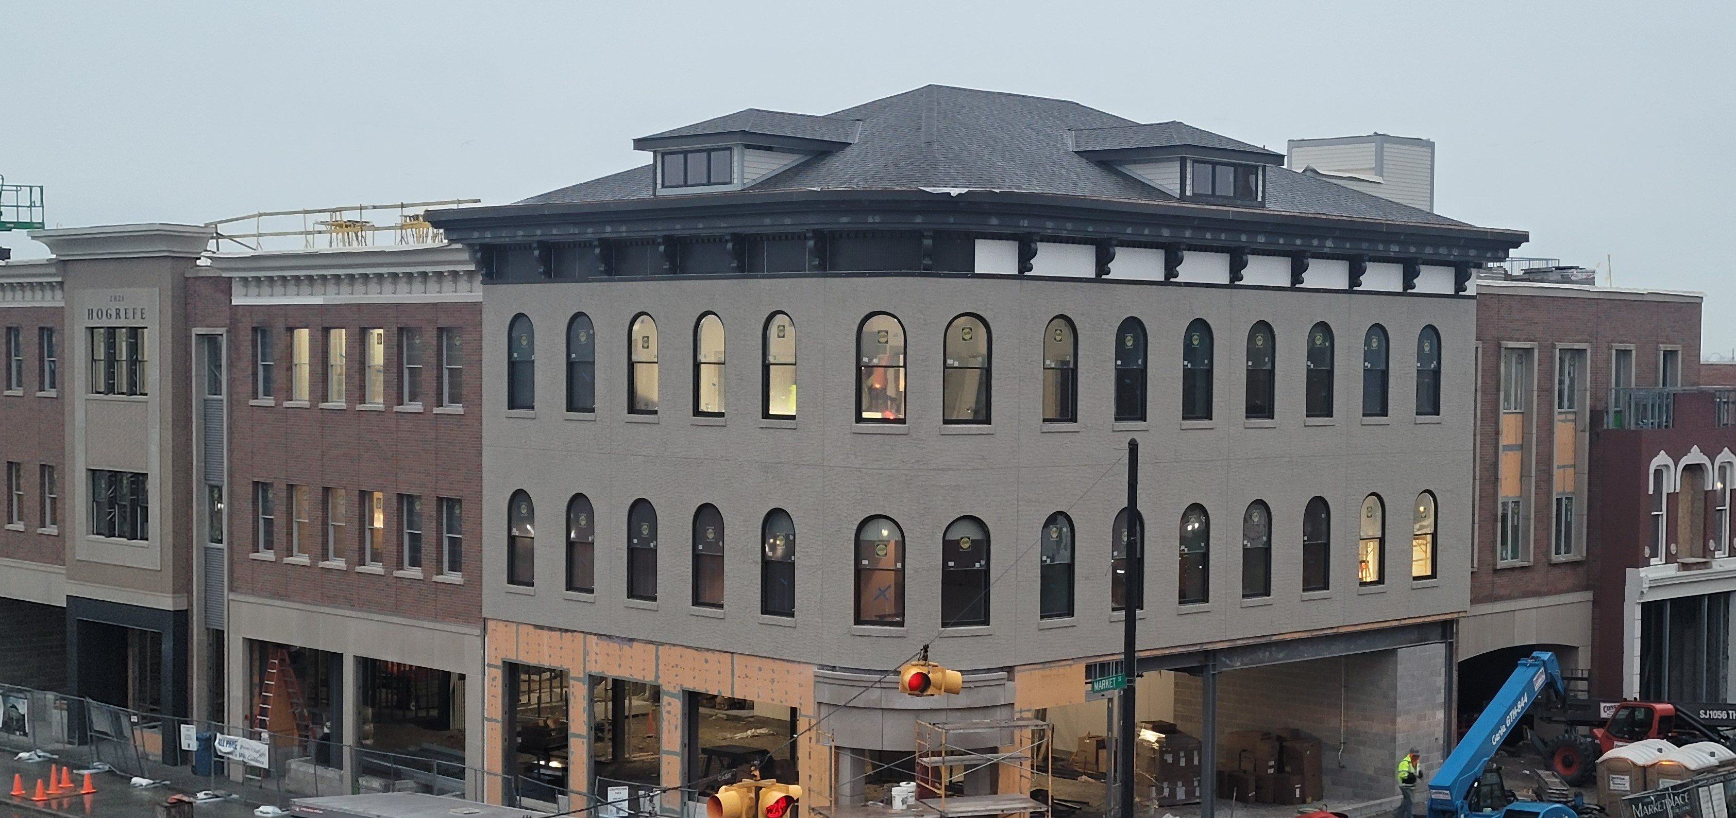
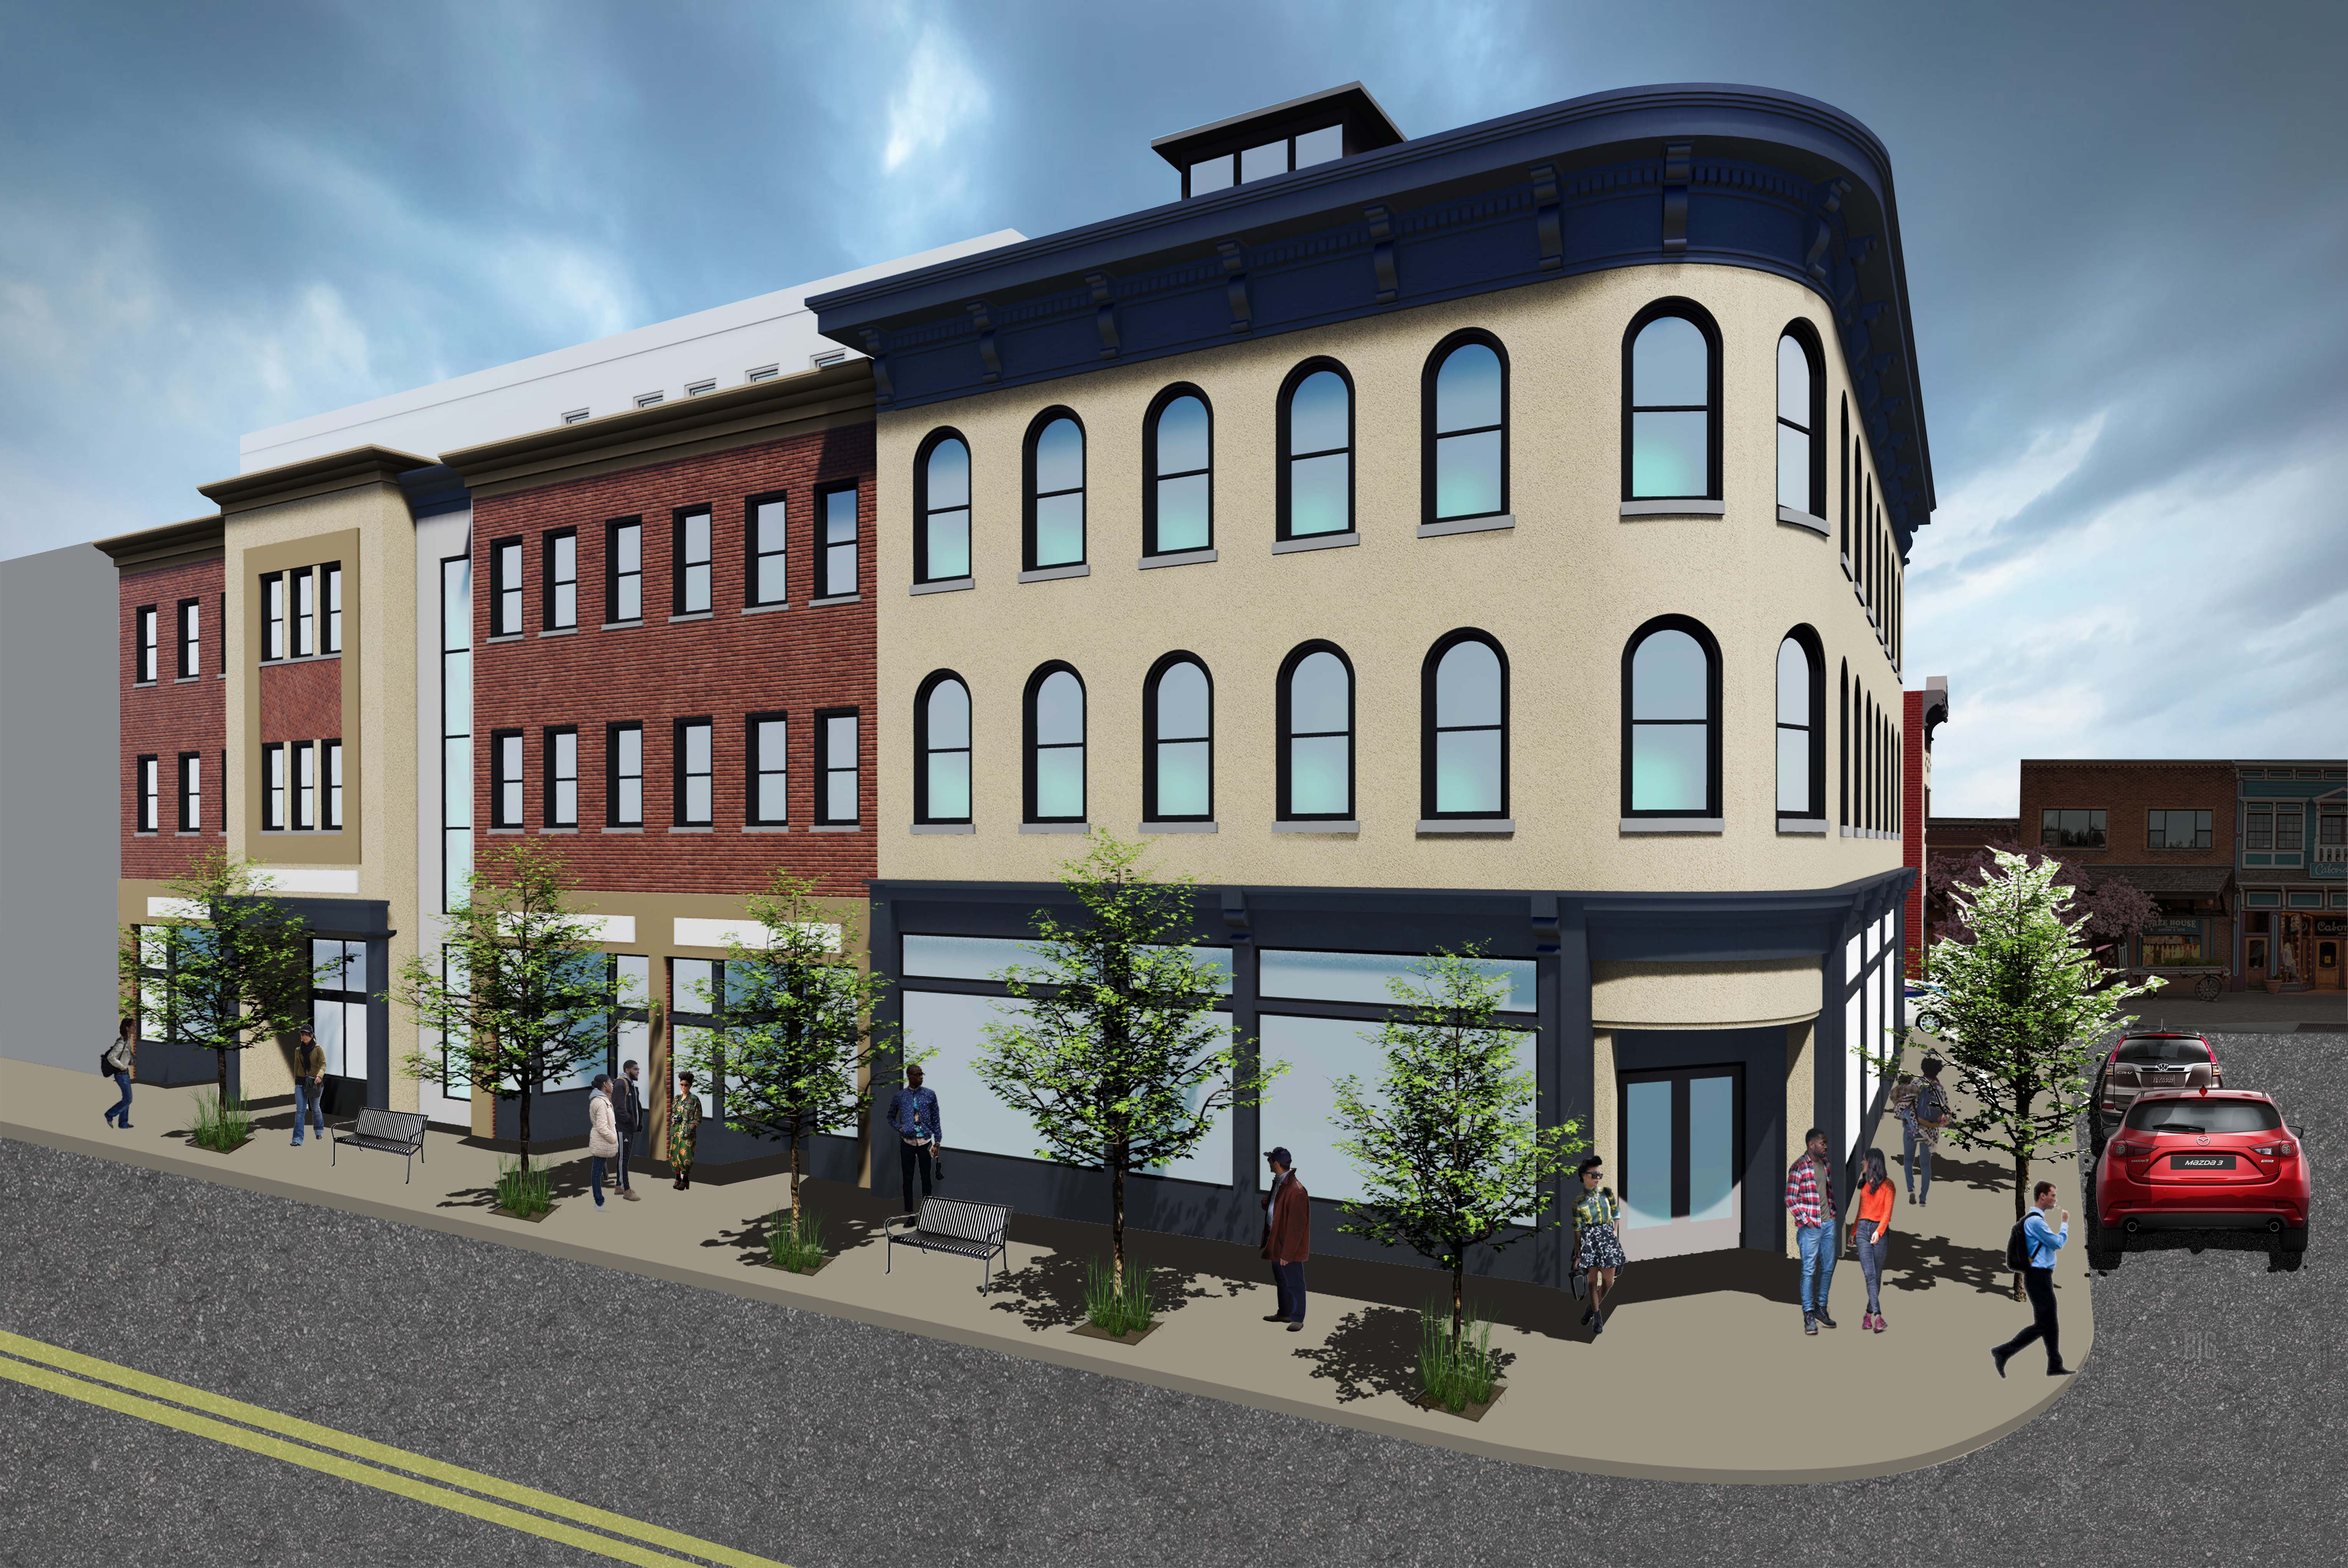

Building for the Future of downtown Sandusky
The Hogrefe Building
Opening Spring 2022
A Prospectus for Potential Commercial Tenants
1/19/22 Version

Slide 2

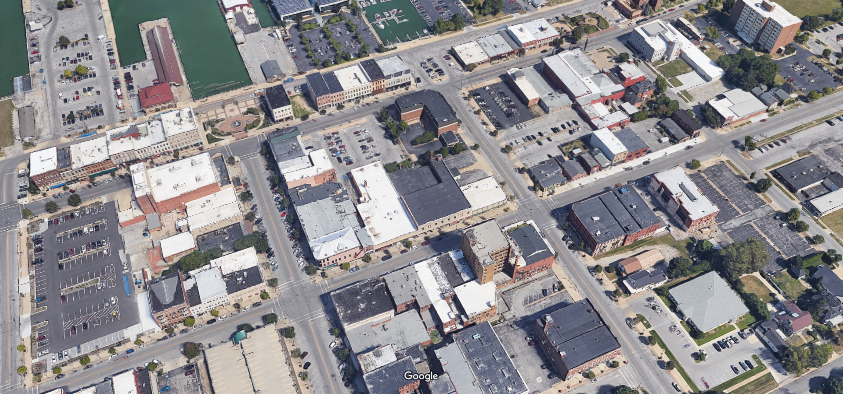
exclusive locations in the Heart of
Downtown Sandusky
H2 PROPERTIES downtown give you built - in foot traffic for business
Primary Location for all business types
RESTAURANT/OFFICE/RETAIL

Slide 3
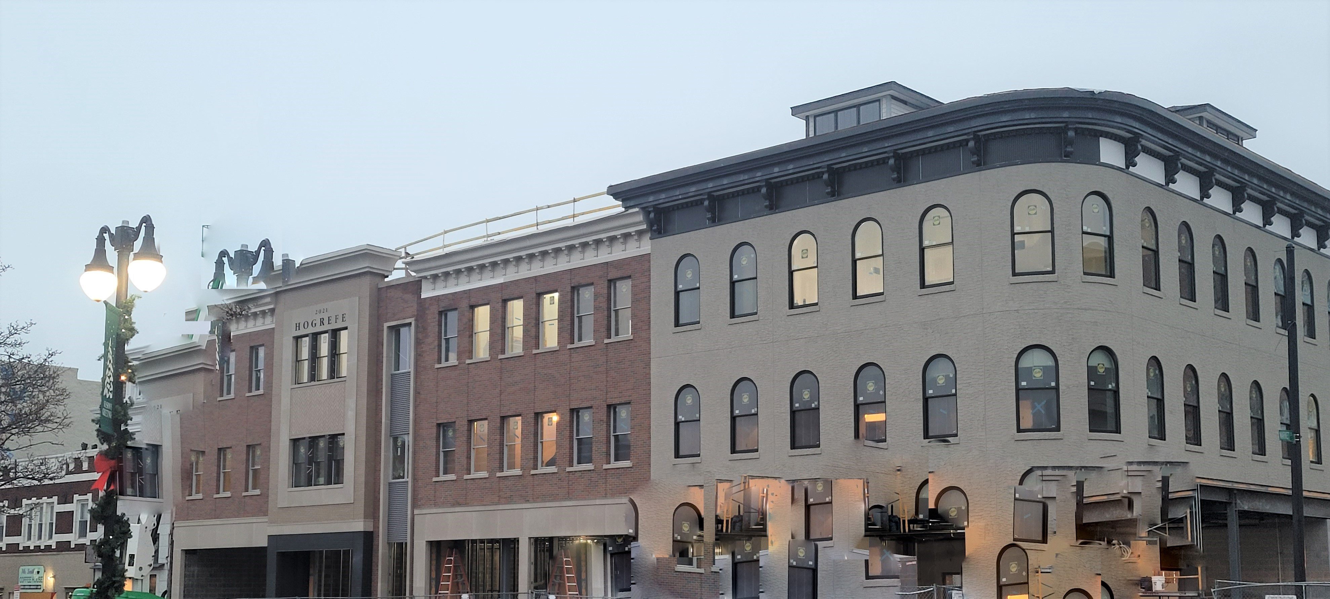
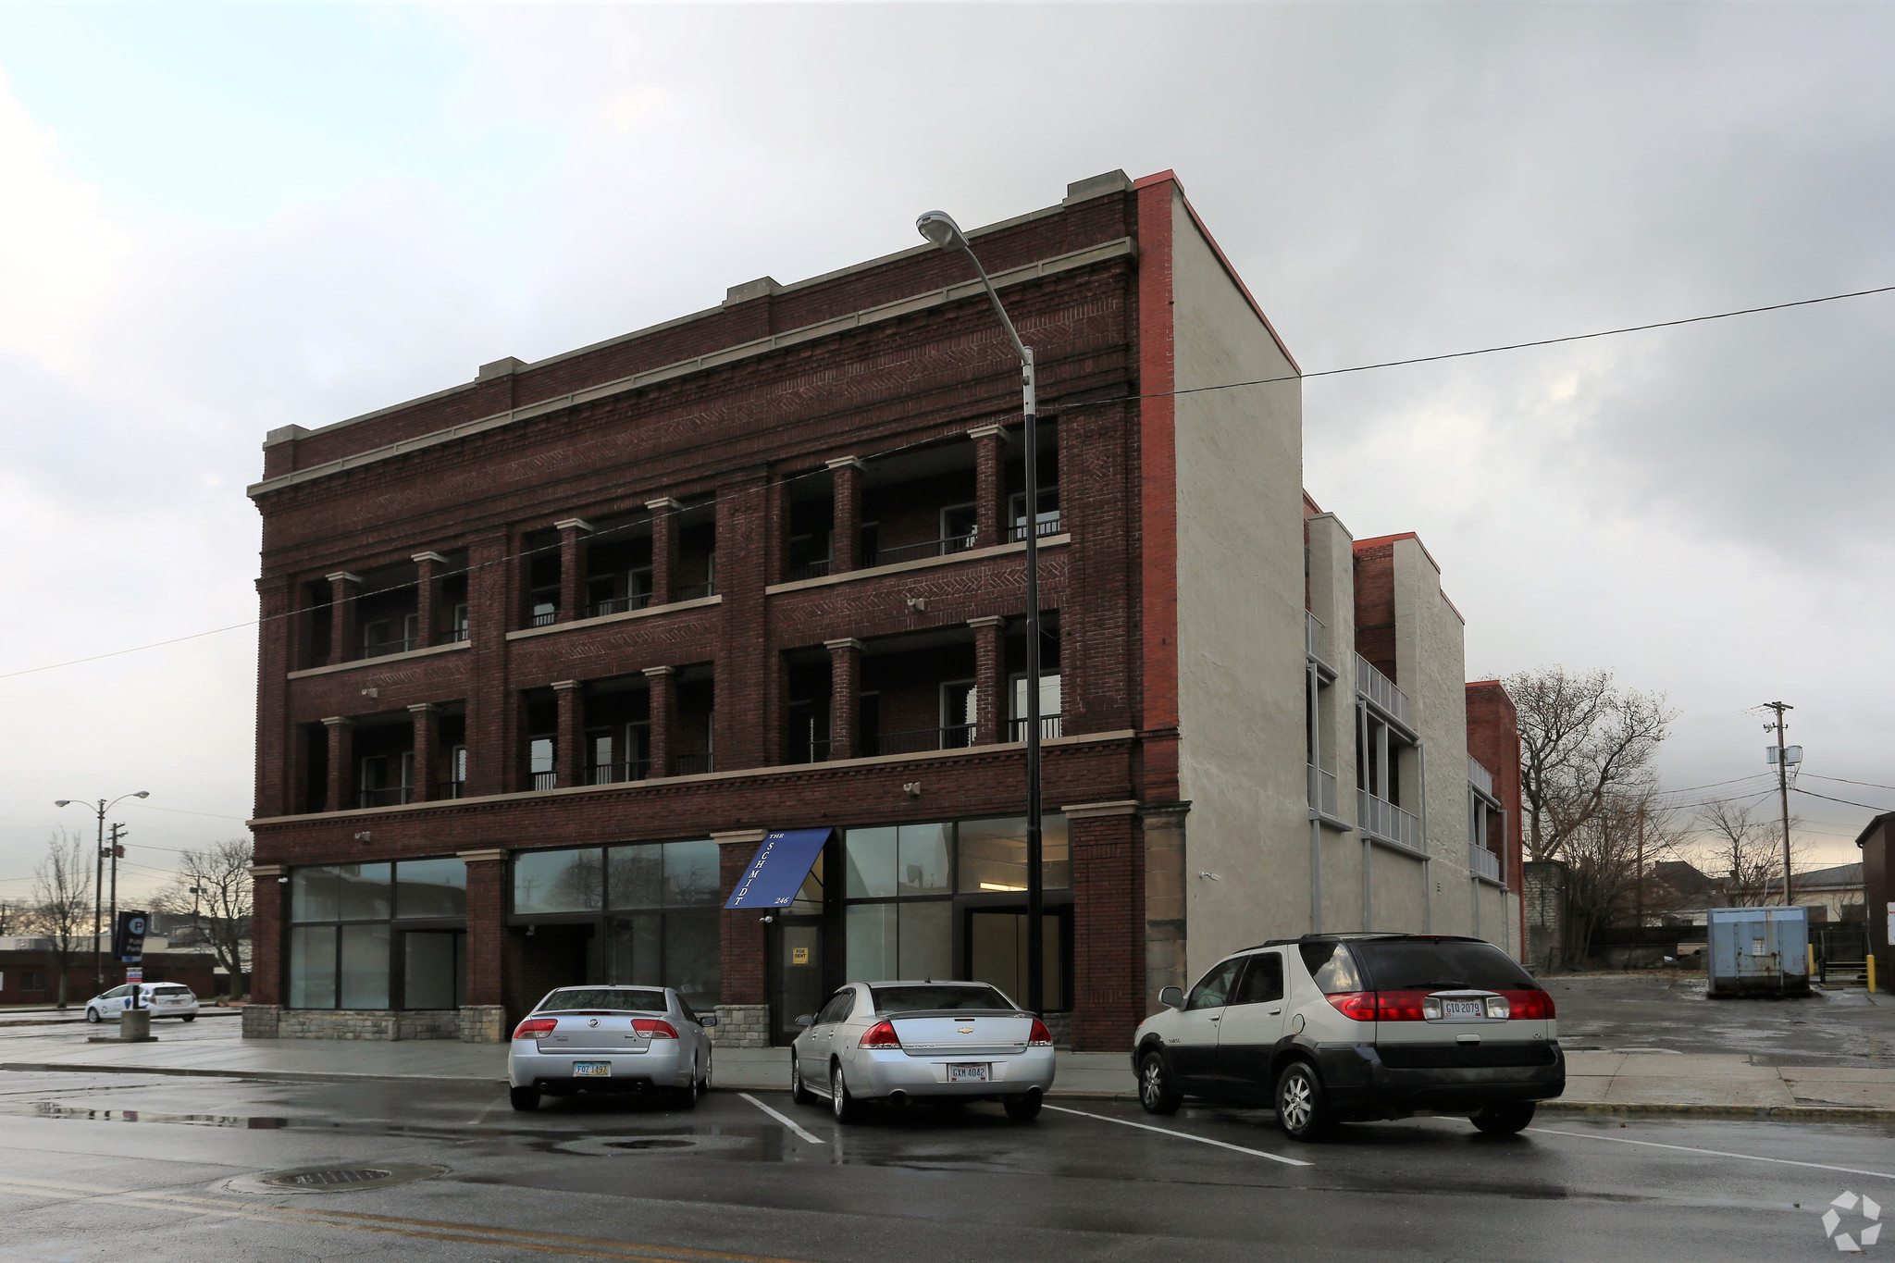
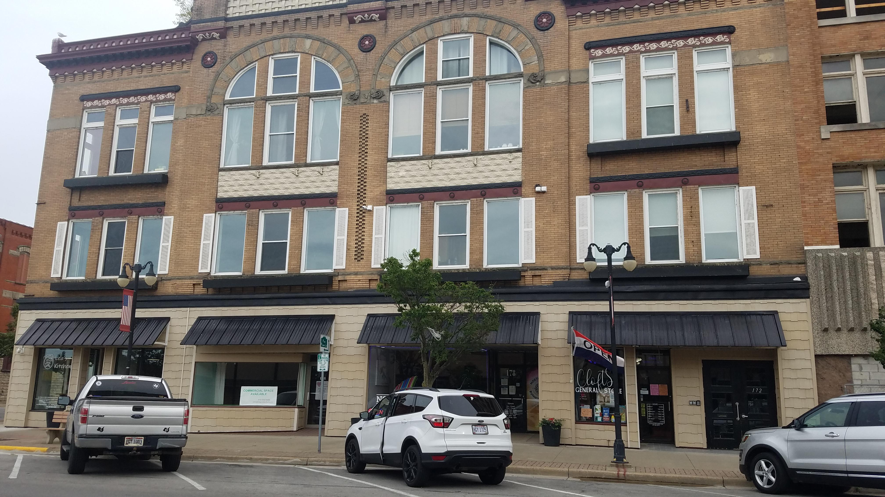
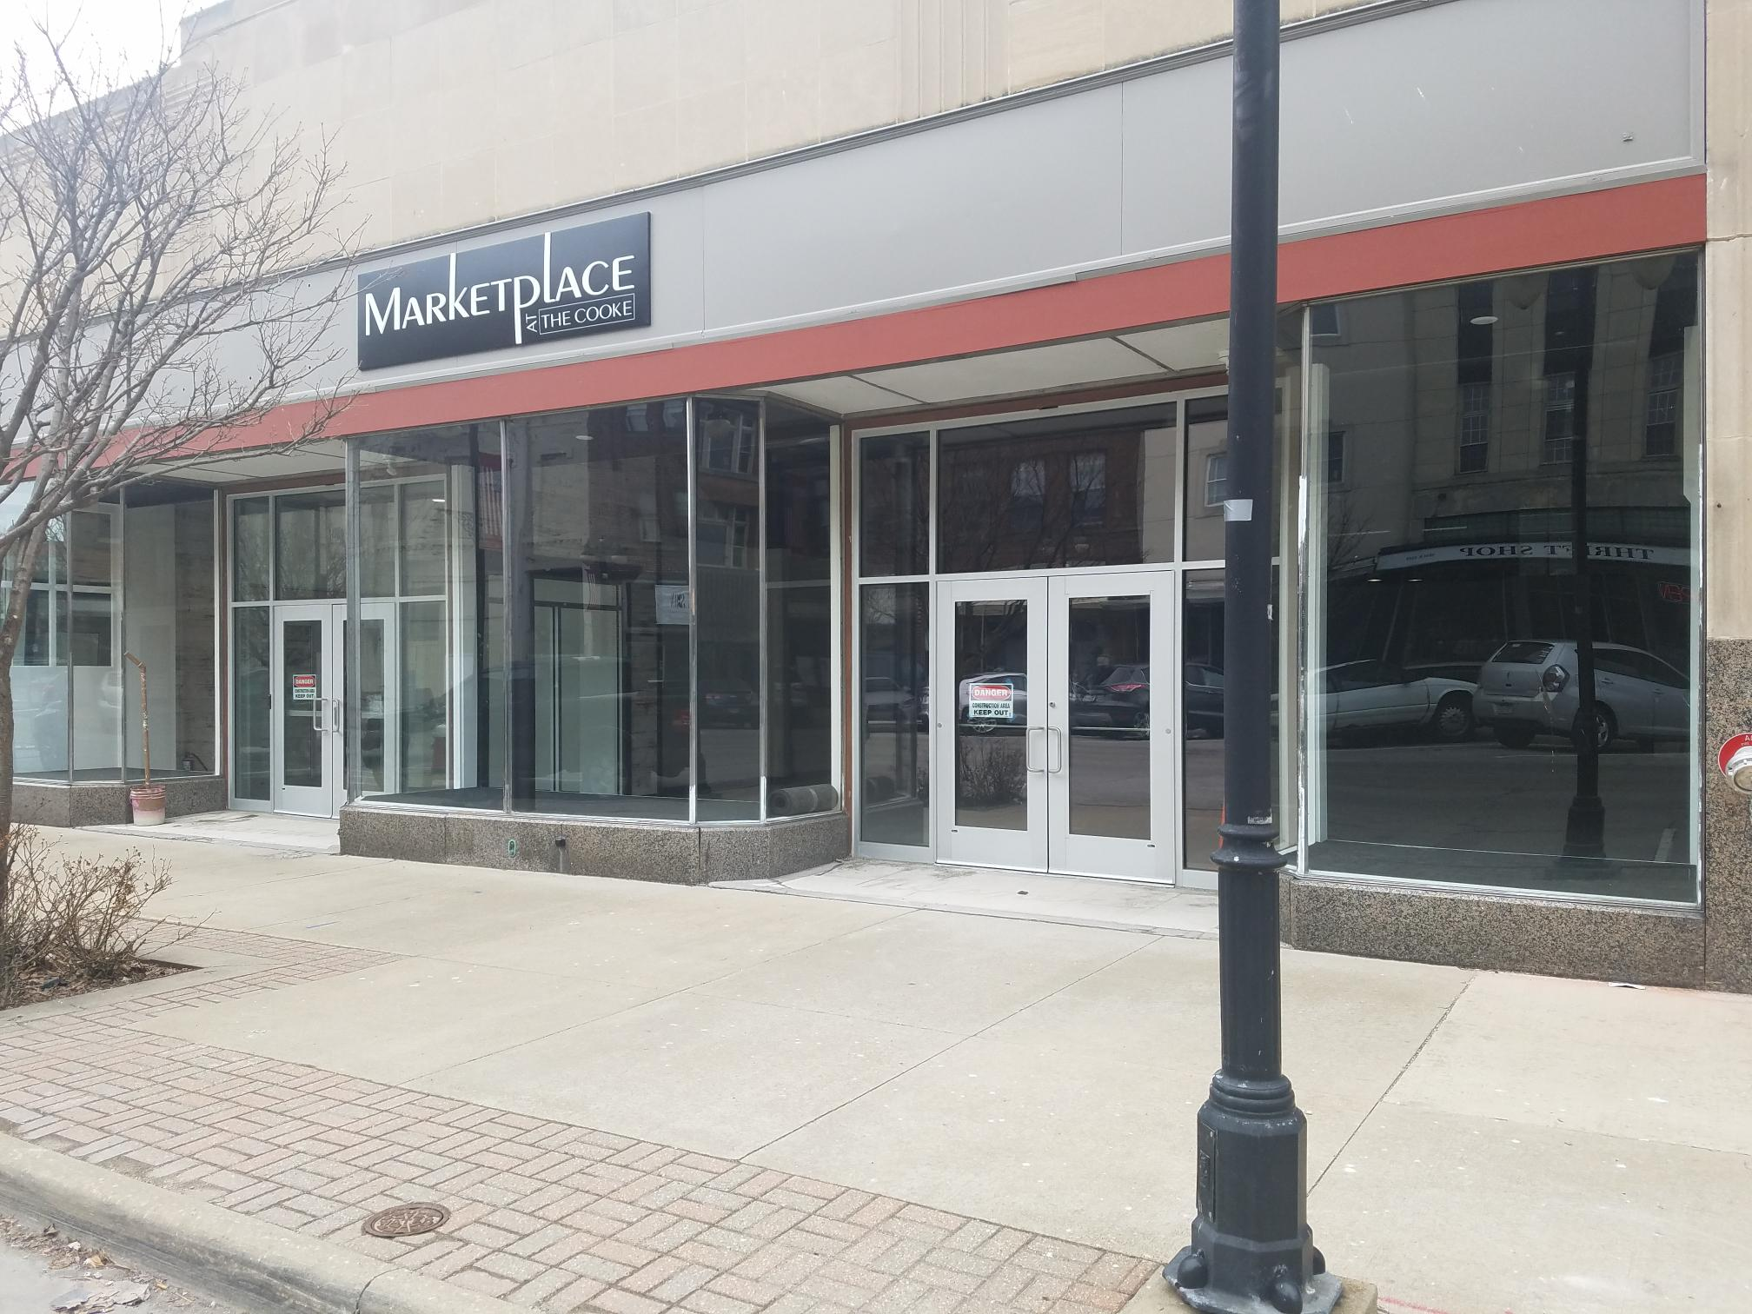
COMMERCIAL Properties AVAILABLE DOWntown from h2 property management
The Hogrefe Building
156 Columbus Ave
3 Spaces
The Schmidt Building
246 E. Market St
3 spaces
The Lea Block
178 and 182 E. Market St
2 spaces
Marketplace Downtown 133 E. Market Street
2 Spaces

Slide 4
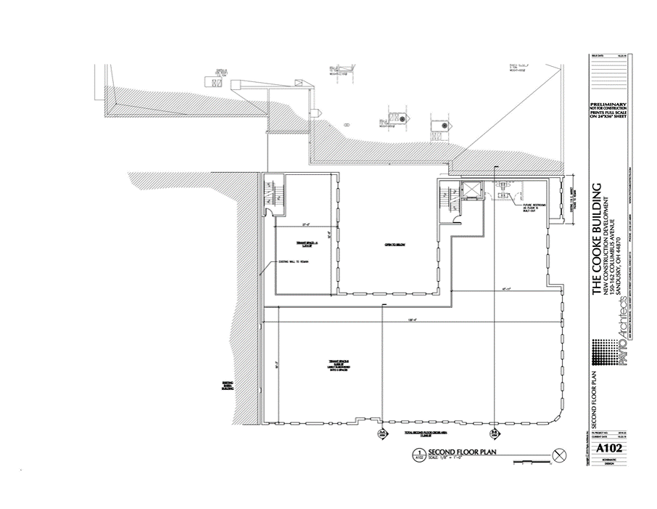
THE Hogrefe building at 156 Columbus Ave
1st Floor Retail space
7090 sf rentable space
  Currently designed into 4 separate spaces. Can combine spaces. All front facing spaces on Columbus Ave, the most valuable store frontage in downtown.
    3243 sf
    1950 sf
    1027 sf
    874 sf (interior space) - Rented
RENTED
2ND FLOOR- RENTED

Slide 5
BENEFITS OF SIGNING LEASE DURING CONSTRUCTION PHASE of Hogrefe Building
Construction will be completed at the end of February 2022
(there is still time)
Maximize Tenant Improvement dollars
  Some Improvements to brand new spaces can be built during construction phase.
  Our construction team will GC the build-out to reduce costs even further.

Slide 6
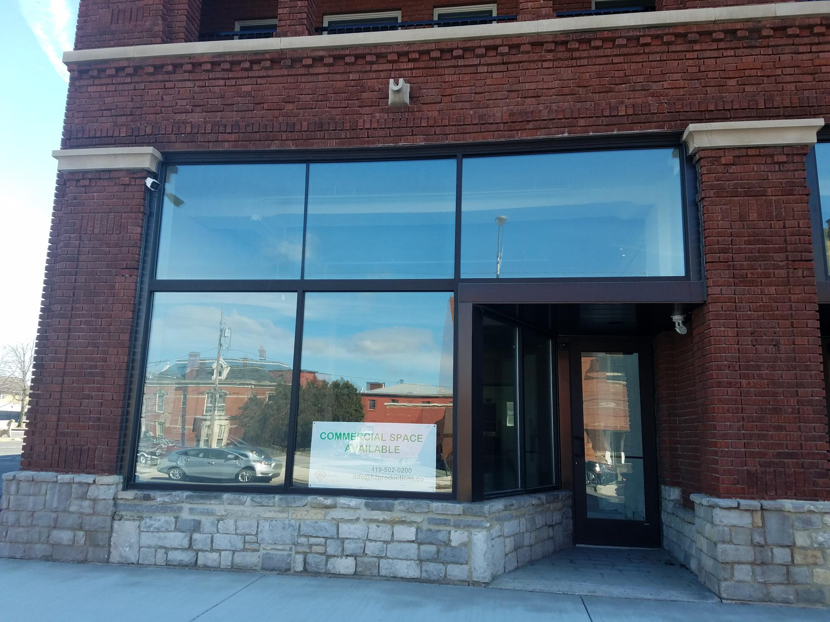
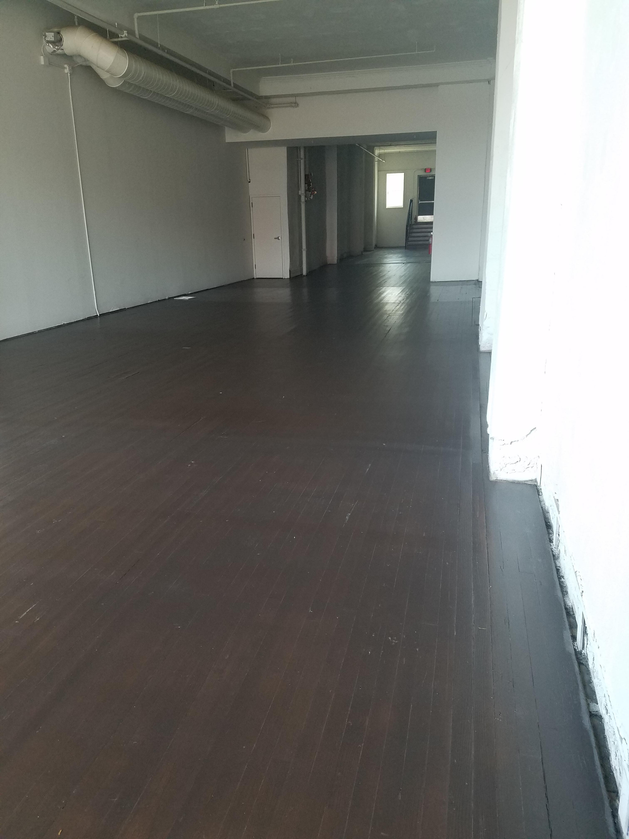
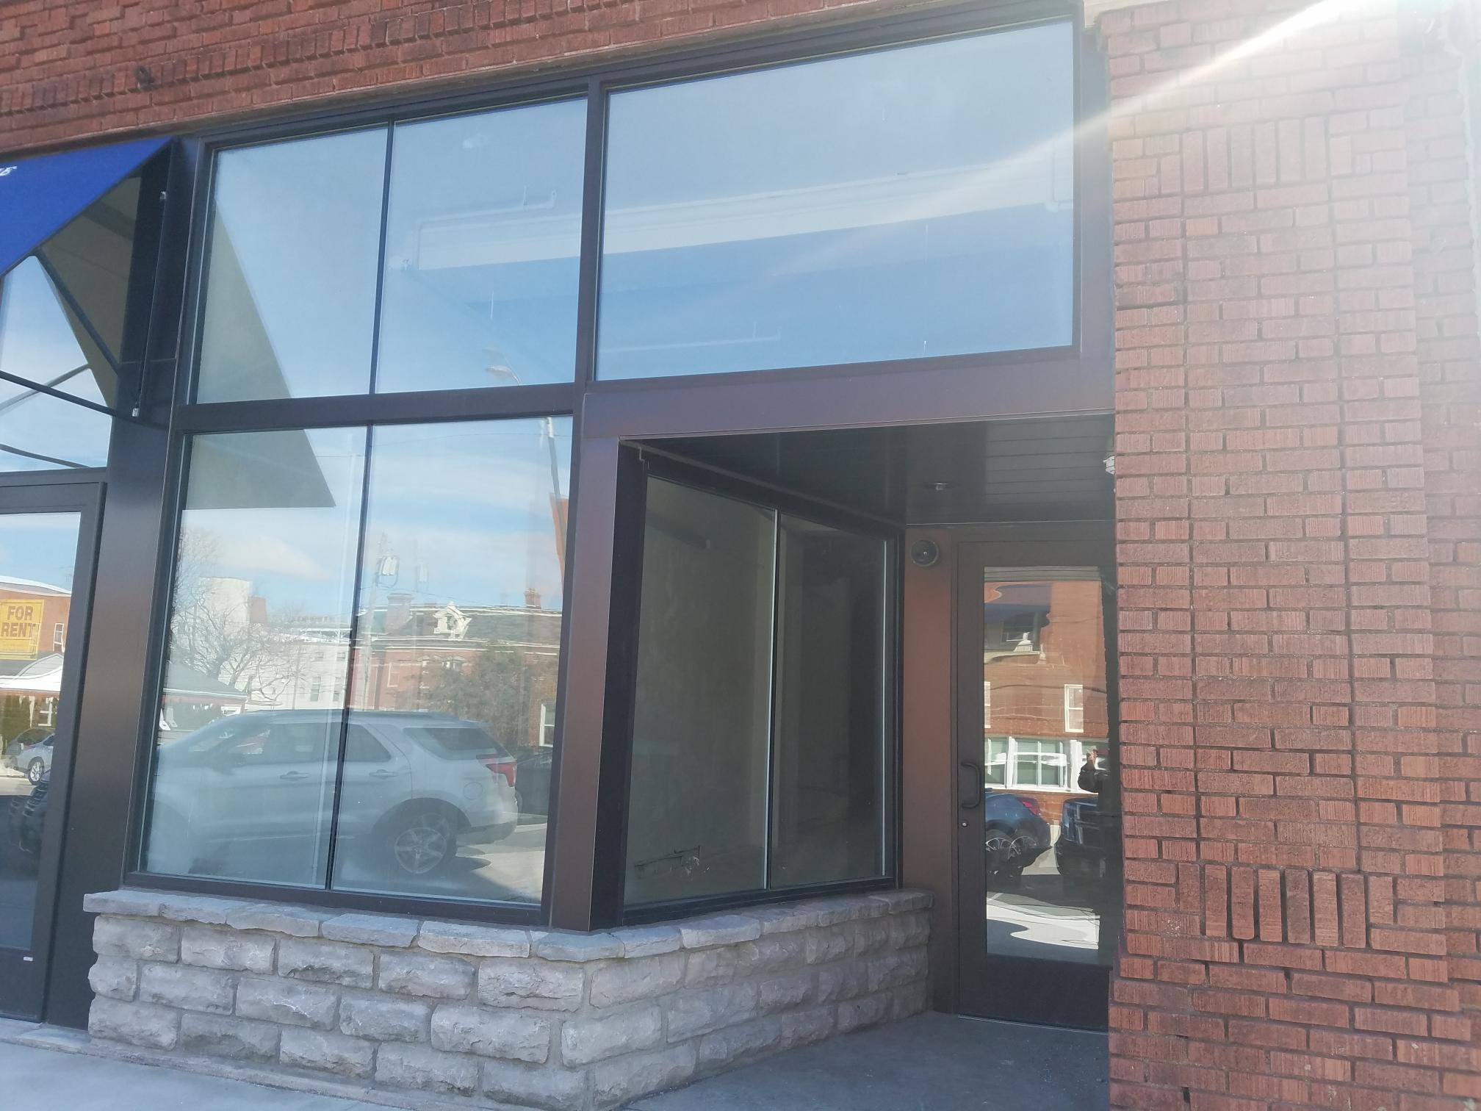
The Schmidt building
246 E. Market Street
6366 sf rentable space
  Currently designed into 3 separate spaces. Two or more spaces can be combined
    2110 sf
    2069 sf
    2187 sf
This is an undeveloped retail/office location. Prime location next to the BGSU/Falcon Point Lofts Apartments, 1 block from the Marketplace Downtown and Hogrefe Building and just 2 blocks from Jackson St. Pier.
Suite 1- 2110 sf
$14 sf/yr. plus NNN
Suite 2- 2069 sf
$14 sf/yr. plus NNN
Suite 3- 2187 sf
$14 sf/yr. plus NNN

Slide 7
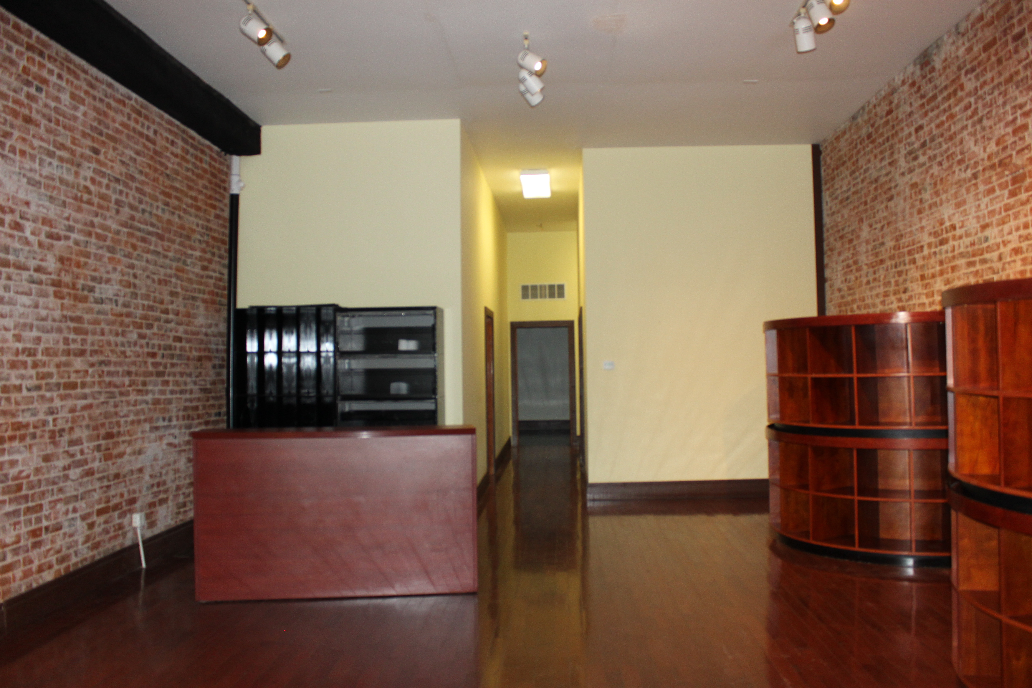
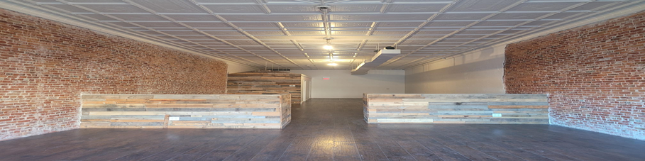
The Lea Block
178 & 182 E. Market Street
A beautiful historic and urban feel, these store front locations are perfect for any retail/office space. Located beneath the soon to be Feick Apartment Building and 1 block from the Falcon Point Lofts, so many people, so much foot traffic.
You are across the street from the Marketplace Downtown and The Hogrefe Building.
178 E. Market Street 1487 sf
Street level/great store front location
$12 sf/yr. plus NNN
182 E. Market Street 1527 sf
Street level/ great store front windows
$12 sf/yr. plus NNN

Slide 8
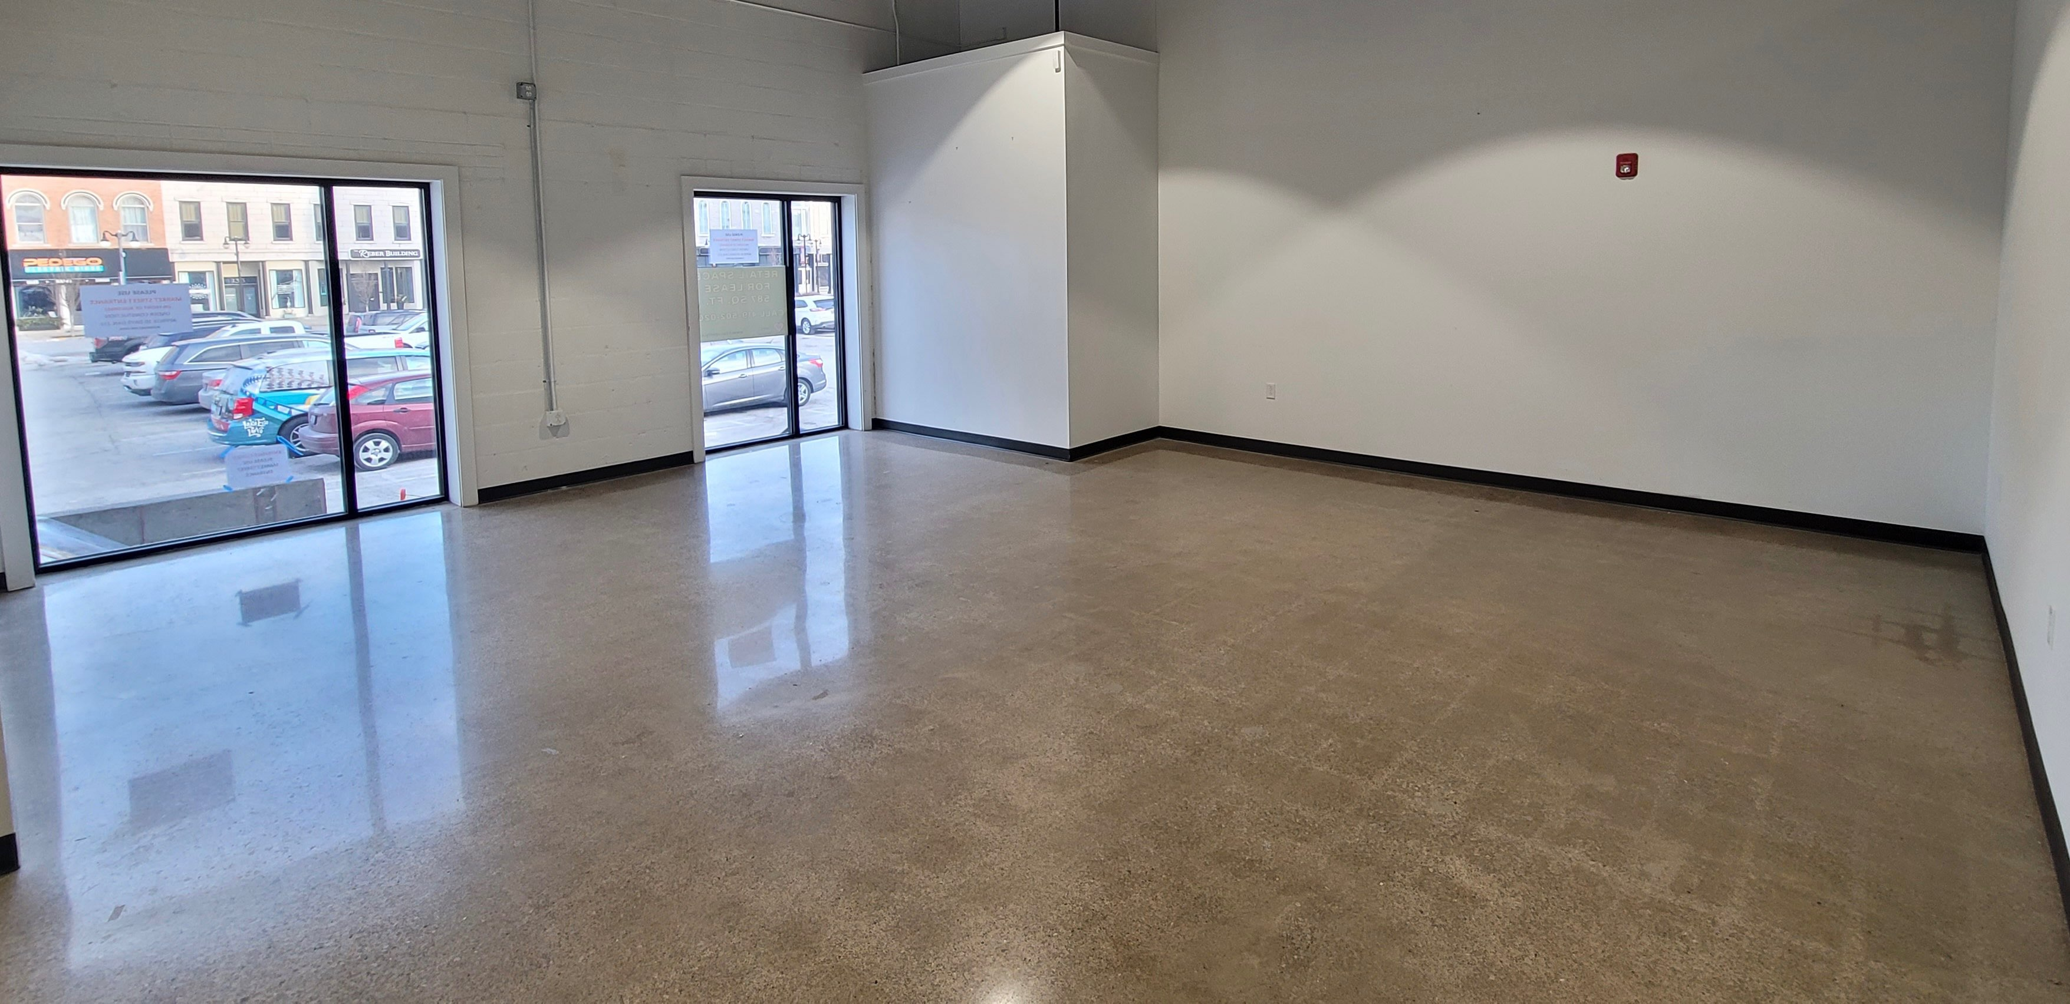
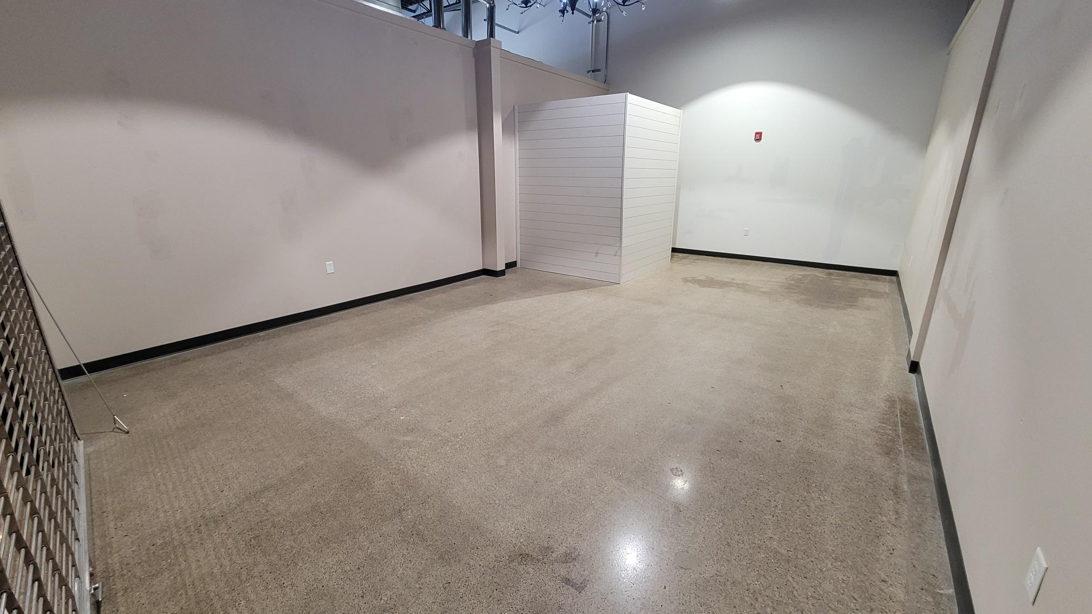
The Marketplace Downtown
133 E. Market Street
An indoor Shopping Experience in Downtown Sandusky
Located in the heart of downtown Sandusky this indoor retail space will have a mix of local shops, food and entertainment. Families can enjoy this location for all activities.
EAT*DRINK*SHOP*PLAY.
587 sf –Water St Frontage
$14 sf/yr. plus NNN
Directly across from Wake up and Waffle
440 sf- Mid-Mall
$12 sf/yr. plus NNN
Diagonal from Wake up and Waffle and next door to Bake Erie
RECENTLY MADE AVAILABLE!!!

Slide 9
RentAL tERMS
Hogrefe Bldg -156 Columbus Ave
$19/sf Base Rent
  Includes $50/sf Tenant Improvement credit
    More improvement money available
Triple Net and Utilities
  NNN expenses estimated at $0.40/sf/month.
10 and 20 year leases available
  Shorter leases possible
Schmidt Bldg 246 E. Market St
Marketplace Downtown 133 E. Market St
$12-$14/sf Base Rent
  Includes $10/sf Tenant Improvement credit
    More improvement money available
Triple Net and Utilities
  NNN expenses estimated at <$0.40/sf/month.
5-10 year leases available
  longer leases possible
Lea Block 178 – 182 E. Market St
$12/sf Base Rent
  Includes $10/sf Tenant Improvement credit
    More improvement money available
Triple Net and Utilities
  NNN expenses estimated at <$0.40/sf/month.
5-10 year leases available
  longer leases possible

Slide 10
Contact information
H2 Property Holdings, LLC
  Main Contact: Richard Hogrefe, Ph.D.
    rhogrefe@H2productions.co
    mhogrefe@h2productions.co
H2 Property Management, LLC
  Main Contact: Sharon Salmon
    ssalmon@h2productions.co
    419-502-0200
    222 Shoreline Dr. Sandusky, OH 44870

Slide 11
Downtown Sandusky Highlights
2019 Voted Best Coastal Town in America USA today
Home of Cedar Point (3.7 miles away)
Kelly’s Island and Put-In -Bay (ferry access daily)
Canada’s Pelee Island (daily trips)
Goodtime Cruise
Iron Man 2022 host city
Jackson Street Pier including the Summer Concert Series
DORA zoned
Neighboring district of the Sports Force Park at Cedar Point Sports Center (3.8 miles away)
Role in history of the Underground Railroad

