Slide 1
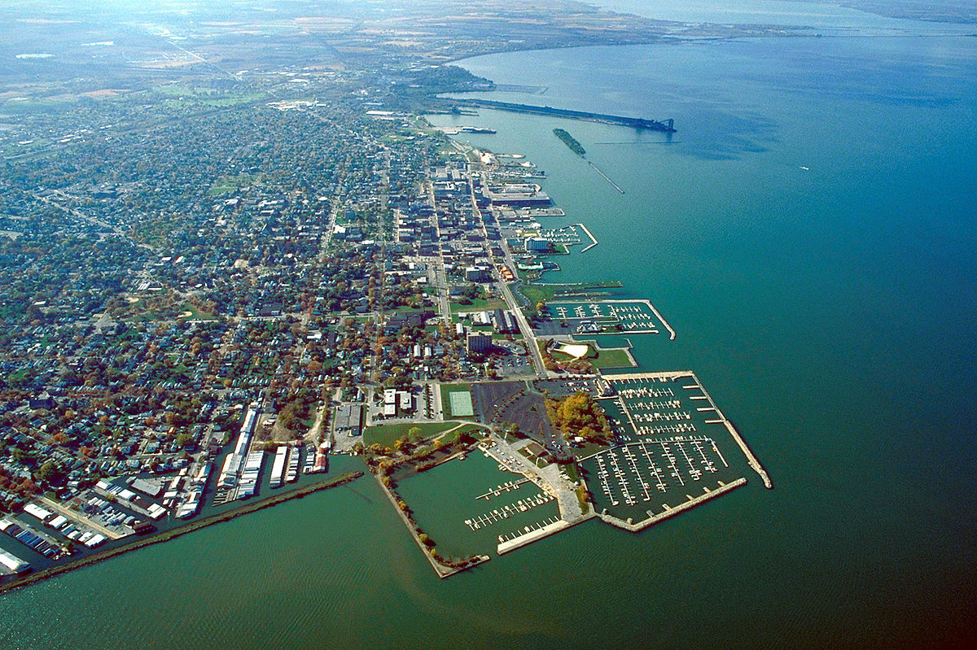
Sandusky Business grant Initiative
Helping Local Businesses
Helping Downtown
Helping Sandusky
A H2 Property Holdings Program
In Partnership with:
The City of Sandusky
Lake Erie Shores and Islands
Erie County Chamber of Commerce
Erie County Economic Development Corporation

Slide 2
Mission
A joint program of the City of Sandusky and H2 Property Holdings (H2), partnering with Erie County Economic Development Corporation, Erie County Chamber of Commerce, Lake Erie Shores and Islands, and RISE to help bring new, local businesses to the downtown district.
Select businesses will receive a grant that will pay a portion of their rent expenses and tenant improvements, allowing their business the financial room to grow into their potential over a period of several years in a high quality space in a prime location.

Slide 3
A Transformation is Happening in downtown sandusky
A historic city that is 200 years old, downtown Sandusky is also transforming into a new regional hot spot.
Many new restaurants and bars have opened in the last few years
Paddle and Climb brings an all-weather attitude to Sandusky with an indoor climbing wall
Ferry service downtown is a short walk away that can take you to the Lake Erie Islands and soon to Cedar Point
More music venues are opening yearly, bringing a vibrant mix of music to downtown

Slide 4
Helping local businesses – new and old
The goal of the program is to help new, local businesses grow with downtown and be part of that transformation.
The cost of entry for a new business is large. The grant will reduce the burden of the high rental rate required to be in a prime location downtown that will allow for success.
This will not only help grantees, but by bringing more businesses downtown, all businesses are beneficiaries. This will help existing business by bringing even more businesses downtown when they see how thriving it is. And more businesses means more customers for everyone

Slide 5
Grant funding
The grant funding is coming from a EDC grant being given to H2 Property Holdings for the reconstruction of the Huntley (now Marketplace at Cooke) and the Cooke Building.
The EDC grant is slated to be $500,000, paid as the construction on the two buildings conclude.
H2 Property Holding is in turn converting that grant into the Sandusky Business Grant Initiative. $450,000 will go directly into grants, while the other $50,000 will be donated to the For Love With Love Charity.

Slide 6
Grant Management
The grant finances will be managed by H2 Property Holdings.
The potential grantees themselves will be nominated by the partnering organizations who will funnel worthy candidates to the voting committee.
The voting committee will consist of Meghan and Richard Hogrefe, 1 city representative, and 1 appointee from each of the partnering organizations.
H2 has the final approval of any leases, regardless of the granting decision.

Slide 7
Grant Program
The grants (10 total) will be for up to $45,000 each as a combination of rent subsidy and tenant improvements.
Year 1 of the lease, the grant can cover up to $8/sf of the rent, to a maximum of $16,000/year.
Year 2 of the lease, the grant can cover up to $6/sf of the rent, to a maximum of $12,000/ year.
Year 3 of the lease, the grant can cover up to $4/sf of the rent, to a maximum of $8,000/year.
This will afford each grantee a maximum total in $36,000 in rent abatement.
Leases must be for a minimum of three years and must include a personal guarantee from the tenant for the remainder of the rent.

Slide 8
Grant Program
The rest of the grant money is to be used for tenant improvements and furnishings if needed. The grantee may request that more is made available as tenant improvement money, and less as rent abatement on a case by case basis.
The grant partners will also provide added benefits to the grant package, including advisement, promotion, and other business support.

Slide 9
Application process
The applicant must submit an application that includes a business plan. Applications will be found on each of the partners websites.
The application will be sent to the nominating groups, who then will submit worthy applicants to the voting committee for final approval.
The Grant Committee will review each application and vote to award a grantee.
H2 Property Holdings has the final approval in all cases.

Slide 10
Spaces available to program
Lea Block (174 and 178 E. Market Street)
(2) Retail spaces on street, ~1500 sf each 3,000
Available now
Schmidt Building (246 E. Market Street)
(3) Retail spaces on street, ~2300 sf each 7,000
Available 10/1/2018
Marketplace at Cooke (125 E. Market Street)
(2) Retail spaces on street, 1600 sf and 2400 sf each 4,000
(4-10) Retail spaces, ground floor interior, 500 sf to 3000 sf each 6,000
(2-4) Retail spaces basement interior, 2000 sf to 4000 sf each 7,000
Available by 11/1/2018
Cooke Building (156-162 Columbus Ave)
(5) Retail spaces on street, 1100 sf to 3400 sf each 9,000
(1-5) Office spaces, 2nd floor interior, 500 sf to 2500 sf each 8,000
Available in Q1 2020
Total square footage available to program 44,000

Slide 11
Granting rounds
Grant Round 1 (2018)
Application period August 1st to September 15th
Application review September 15th to October 1st
Committee vote October 1st
Lease approval October 5th
Additional rounds to be announced if required.

Slide 12
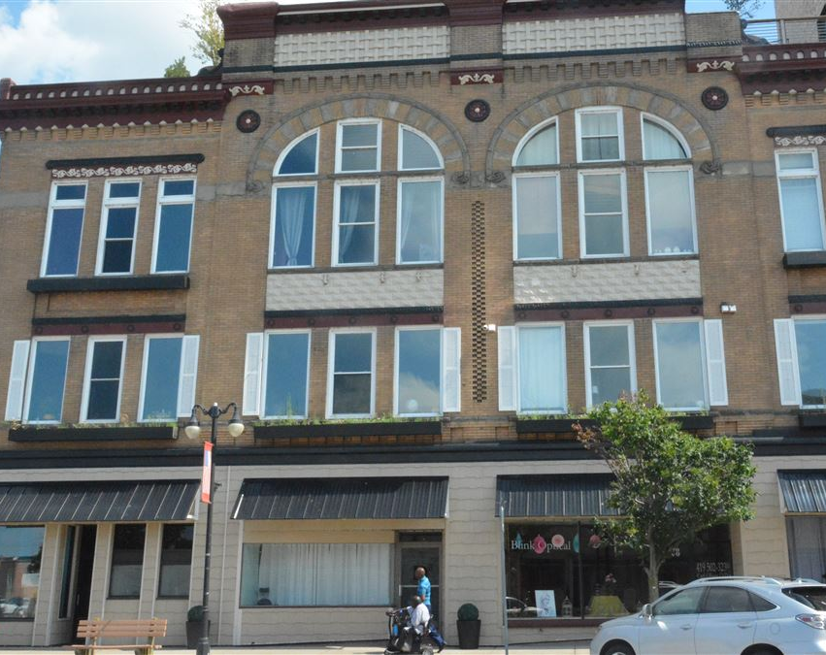
The Lea Block

Slide 13
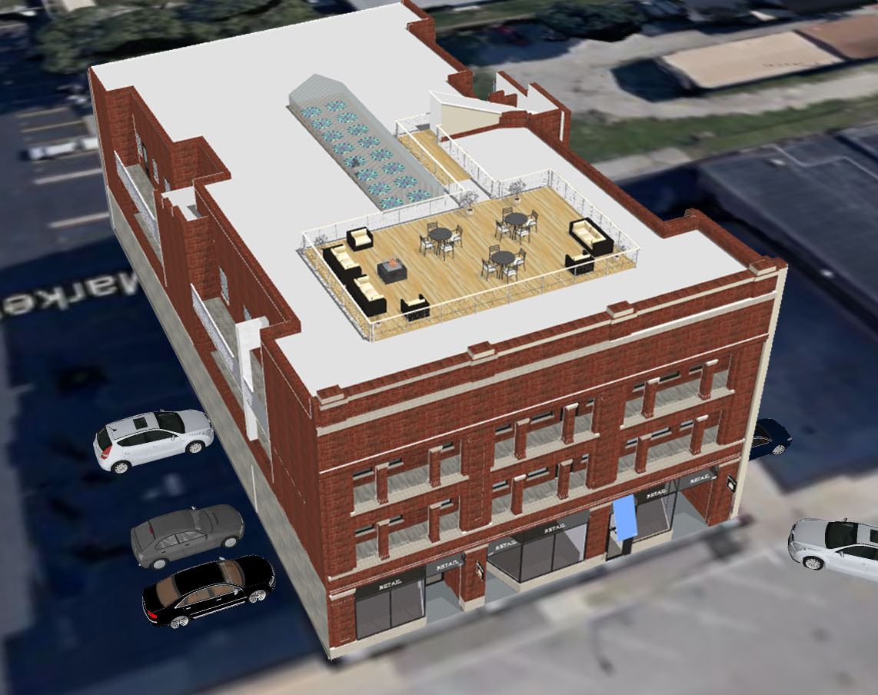
Schmidt building

Slide 14
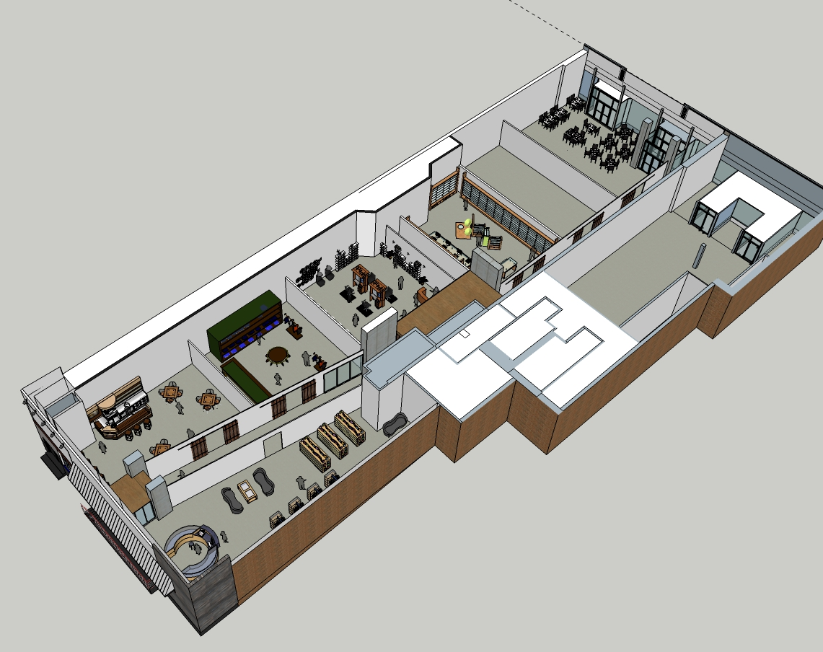
Marketplace at Cooke

Slide 15
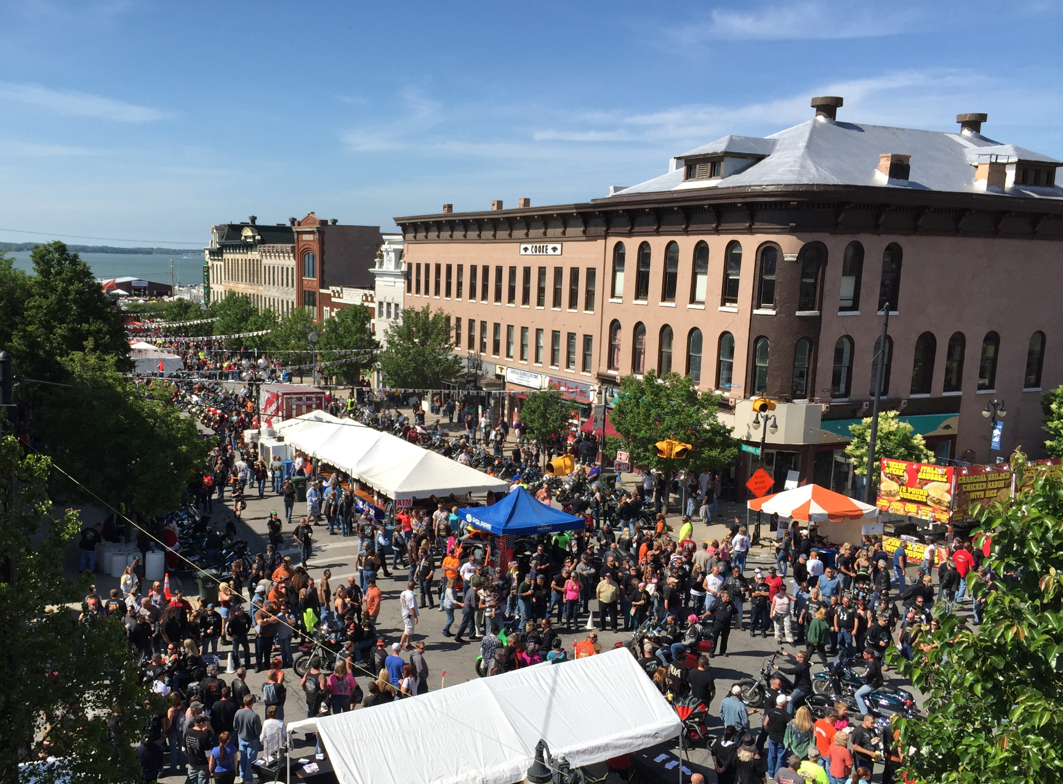
The Cooke Building

